Slide 1
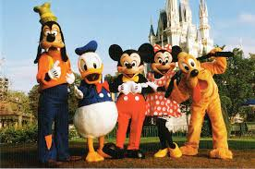
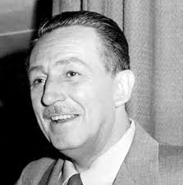
Welcome
Business Meeting
18 May 2016
Breakfast with Walt’s Friends
Marquis Ballroom, Marriott Hotel
Anaheim, CA

Slide 2
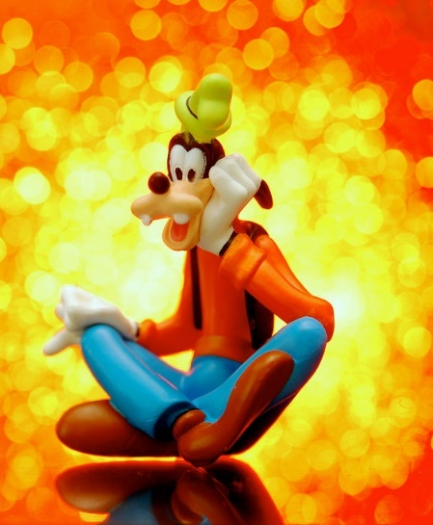

Business Meeting
18 May 2016
Agenda
Welcome & Introductions
Treasurer’s Report
Committee Updates
Volunteer Vacancies
Drawing for Door and Costume Prizes

Slide 3

Introductions
We all have superpowers! …What’s yours?
(‘round the table introductions – where y’all from?)

Slide 4
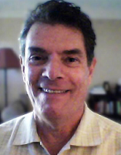
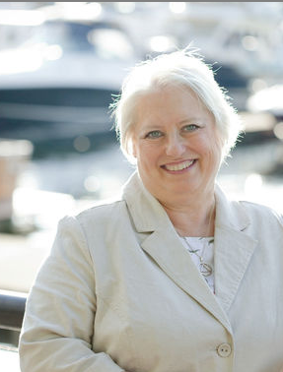
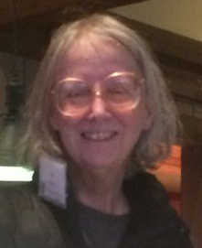
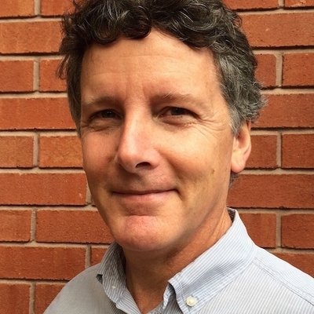
Introductions
Your elected officers
Robert Hershenow and Mellissa Ruryk
So long… and thanks for all the fish!
Secretary: Lori Meyer
Lori is one of our incoming co-managers
(along with Viqui Dill),
so we need to replace her!
Treasurer: James Bousquet

Slide 5
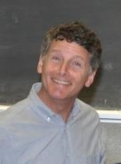
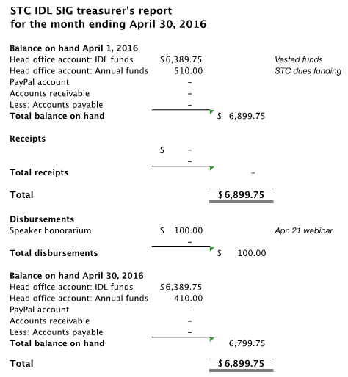
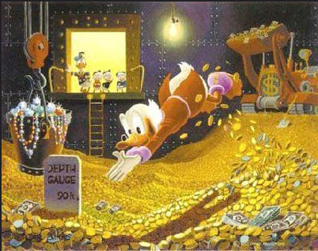
Treasurer’s Report
James Bousquet

Slide 6
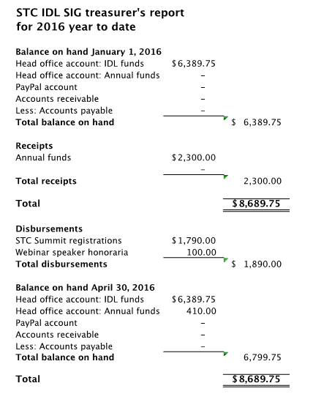
Treasurer’s Report
James Bousquet

Slide 7

SIG Committee Highlights
Finance
Membership
Publicity
Surveys
Social Media
Student Outreach
Programs
Website
Newsletter
Training Evaluations
Mentoring
11 committees =

Slide 8
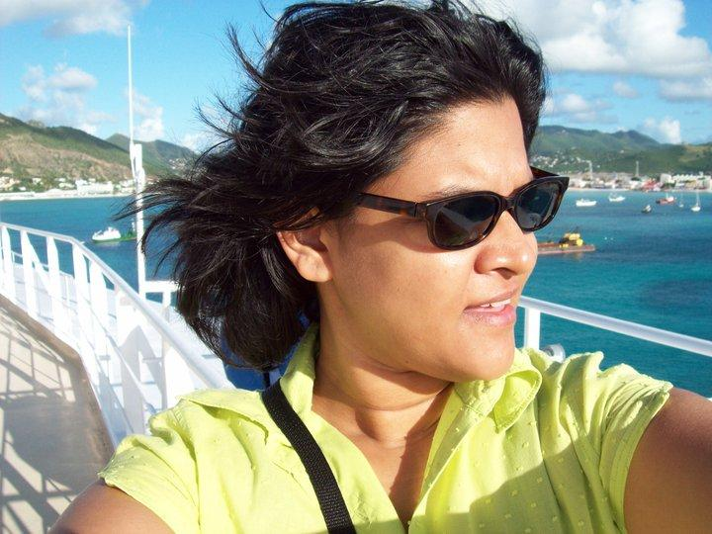
Newsletter
http://www.stcidlsig.org/newsletter-blog/
Crista started by Googling “wordpress”
and “html” – now look at her (what a star!)
New this year: Member blogs.
Next issue due out June 2016 - copy deadline is Tuesday June 7.
Why not write a review of a Summit experience? Be a published author!
Send your submissions to newsletter@stcidlsig.org
Crista Mohammed

Slide 9
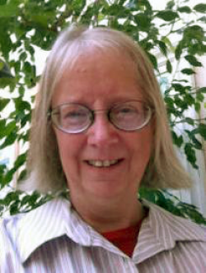

Membership Committee
Bringing Members Together
Member spotlights in newsletter
Sends regular New member welcome
emails
Follows up with members who did not
renew
Canvasses members to apply for
Associate Fellowship and
Fellowship grades
Tweets and publicizes upcoming events
2015/16:
Lori Meyer, STC Fellow
?
2017/18: vacant

Slide 10
Membership Statistics
Membership
Members as of 04/27/2016 - all 505
New SIG members since 01/01/2016 79
New SIG members in the last 30 days 15
By Grade:
  166 Members – Senior (SRM)
  12 Associate Fellows (ASF)
  16 Fellows (FEL)

Slide 11
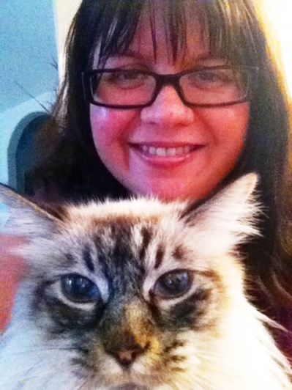
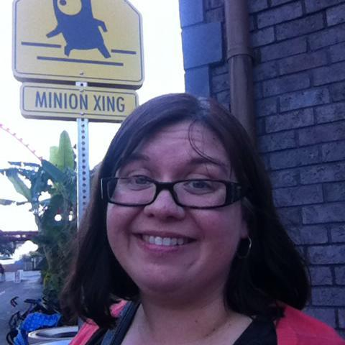
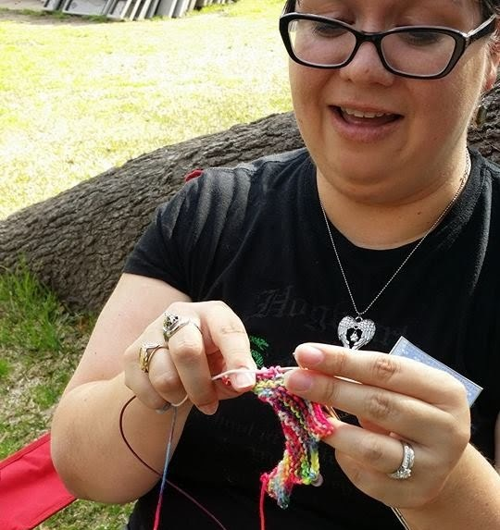

Survey and Social Media Committees
Jamye Sagan
Conceived of, prepared for, and conducted the third Virtual Open House to let prospective members know what they could expect from joining the SIG.
Runs the annual elections; does membership surveys, tweet and posts on social media, also past co-manager
Avid knitter, crocheter and craftswoman

Slide 12
Social Media & Publicity
Managing our online presence
Social Media Outlet | Name of Group | Stats (as of 27 April. 2016) | URL
LinkedIn | STC Instructional Design and Learning SIG | 359 members (up 1 from Feb.) | https://www.linkedin.com/groups/2298157
Facebook | Society For Technical Communication - Instructional Design & Learning SIG | 89 likes (up from 86 likes in Mar.) | https://www.facebook.com/STCIDLSIG
Twitter | @STC_IDL_SIG | 97 following 376 followers (up from 367 in Mar.) 410 tweets (not counting retweets and likes) | https://twitter.com/STC_IDL_SIG
When you tweet, use #STC_IDL_SIG

Slide 13
Publicity
Publicity sends announcements to all members about webinars & upcoming events
Contributes to STC Community Calendar
Maintains the IDL SIG Calendar
Needs a Team Lead… is that YOU?
?

Slide 14
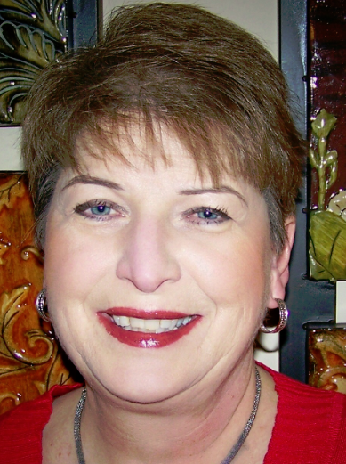


Student Outreach
Writing Competition
Sylvia Miller, STC Fellow
We have created a new student outreach program to promote Instructional Design and Learning and STC/SIG membership. College/university students submit an original article on ID-related topics; they can win a year’s student membership in the STC (including IDL SIG membership).
Winning articles will be posted on the IDL-SIG website and published in our IDeaL newsletter, as well as submitted to the Technical Communication Body of Knowledge (TCBoK).
If the articles are then accepted by the TC BoK editors, the SIG will award the writer $75 towards a further year’s membership.
Further details, including starting dates, entry deadlines, and writing criteria for the 2016 competition will be announced shortly.

Slide 15
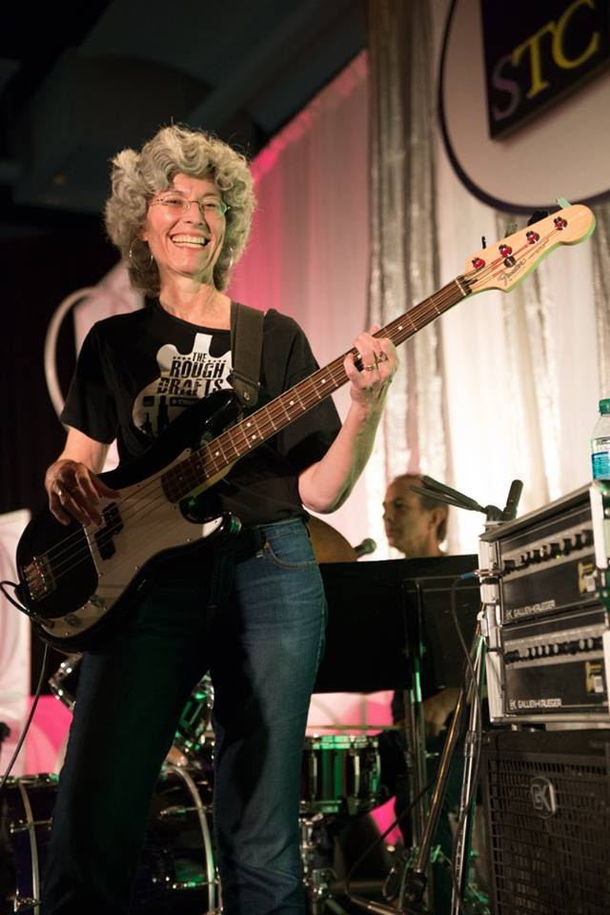
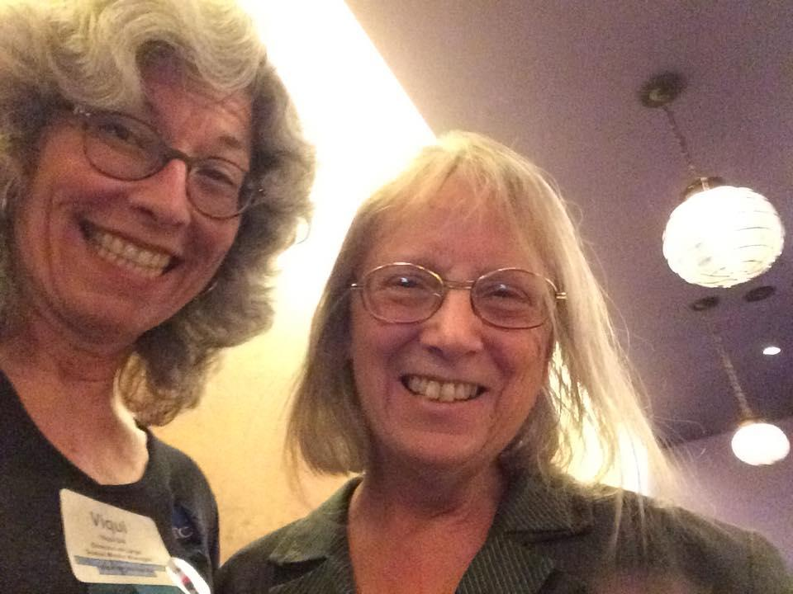
Programs, Web Site
Viqui Dill
Guitarist, singer, mom, volunteer extraordinaire
one of our incoming co-managers: need to replace her!
?

Slide 16
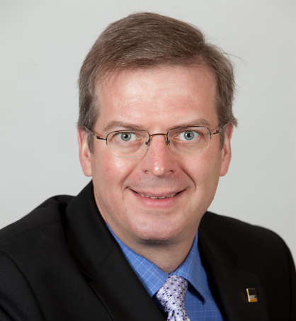
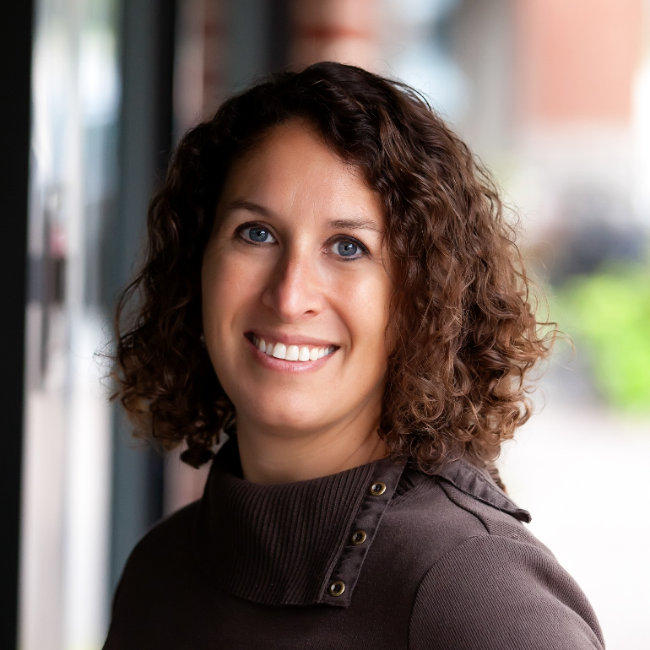
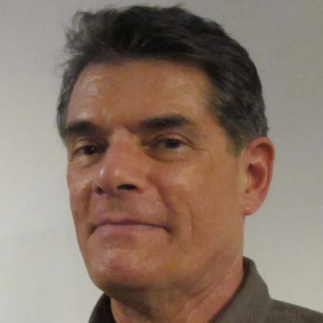
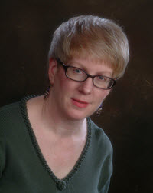
Recent Programs
Mar 2, 2016: STC Multi-community Tech Comm showcase (#2)
April 21, 2016: “Getting Started with Video Training” webinar with Mary Whalen (Sojoodi)
STC Certification: Why, and Where are we Now? presented by Alan Houser
Audio Editing Tips: 3 Easy Steps to Improved Voice Recording presented by Robert Hershenow
The Science and Psychology of Persuasion presented by Barbara Beresford

Slide 17
Programs
Want to present a webinar?
Want to request a webinar
on a specific topic? Contact
manager@stcidlsig.org
New this year: free attendance at IDL SIG webinars for SIG members; free recordings of past webinars (password protected)
Tell your friends: the cost to attend for a non-SIG members is $10 - that’s the same cost as becoming a SIG member. After that, all future webinars are “free”.
?
2017/18: vacant

Slide 18
Website
Viqui Dill
Visit us at www.stcidlsig.org
2015 re-architecture and reorganization resulted in some impressive statistics:
Google analytics:
416 sessions in the last 30 days
250 users
939 pageviews
91 newsletter
56 webinar
54 events calendar
17 see you at the Summit
Need content for these pages:
    mentoring
    membership
    student outreach
    business directly (listing independent ID practitioners)
?
2017/18: vacant

Slide 19
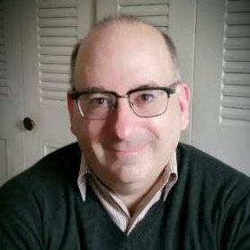
Mentoring
http://www.stcidlsig.org/mentoring
Current Number of Participants (as of April 2016)
  44 Mentors (5 from the IDL-SIG)
  235 Mentees
  15 Mentees served by IDL-SIG (Continental US & Hawaii)
Method of Interaction
  STC Mentor Board http://www.stc.org/education/1414-mentor-board
Constant Need for Mentor Interaction
  The STC Mentor Board Interaction is self-sustaining
  Those willing to mentor or be mentored create accounts and search for individuals whom they can assist
  Rewards
  Mentees appreciate the advice to kick-start their new career goals
  Mentors have the satisfaction of giving back to the community
Scott McCoy

Slide 20
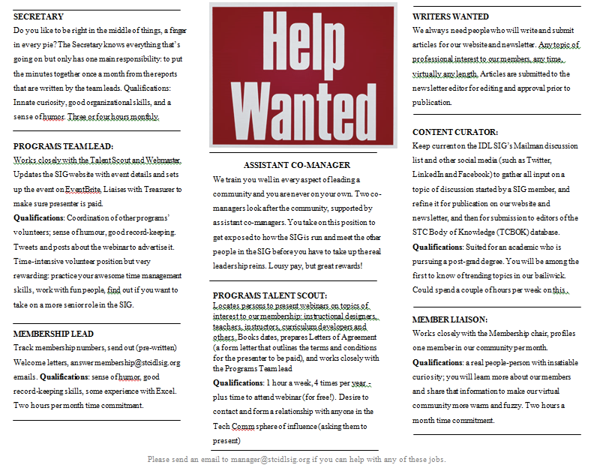
Volunteer Needs
Assistant co-Managers
Secretary
Programs Lead
Website Lead
Membership Manager
Programs Committee Members
Web & newsletter copy writers
For descriptions of tasks, time commitments,
and inspiration, check out: http://www.stcidl-
sig.org/about-idl-sig/volunteer-opportunities/
?
2017/18: vacant

Slide 21
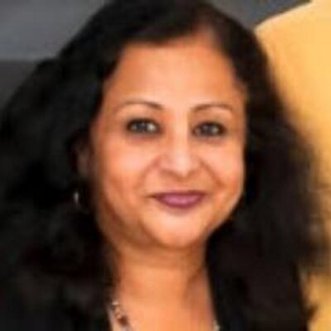
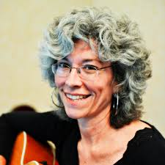
DSSA Winners
Congratulations to our two STC Distinguished SIG Service Award (DSSA) winners:
Preeti Mathur
Viqui Dill
In recognition of her exemplary patience, dedication, and diplomacy in co-managing the SIG, while simultaneously overseeing the training evaluation program, and porting the web site to a new hosting service.
For her superpowers, used in our SIG to lead both Programs and the Web site teams, that she expresses with grace and good humor.
Our deepest thanks to Preeti and Viqui for your service
to the IDL SIG—and heartiest congratulations on your
richly-deserved DSSA awards!

Slide 22
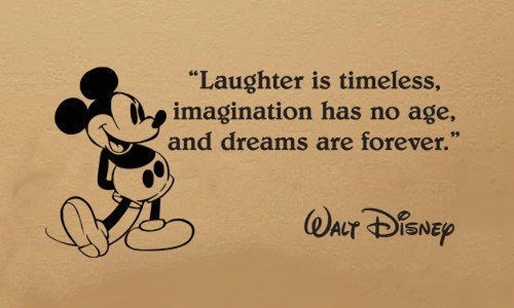
Walt Disney quote

Slide 23

Door and Costume Prizes
Door Prize: a free STC Webinar!
Best T-Shirt!
Best Hat!
Best
Accessory!
Best Ears!
Best Jewelry!
Costume Grand Prize: a free STC Webinar!

Slide 24

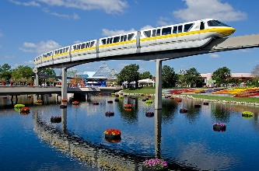
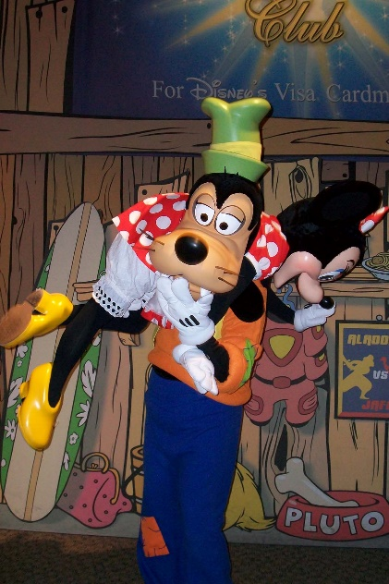


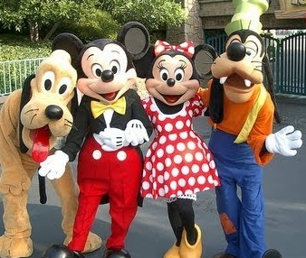
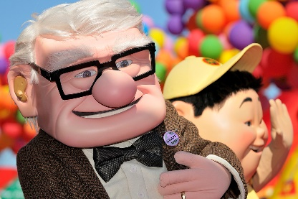
Wrap Up
Any final comments?
Thank you and goodbye!

