Slide 1






of a TechComm Ninja.
A day in the life

Slide 2





Slide 3




TechComm Ninjas are all around us!

Slide 4



N.I.T.
Ninja Institute of Technology

Slide 5
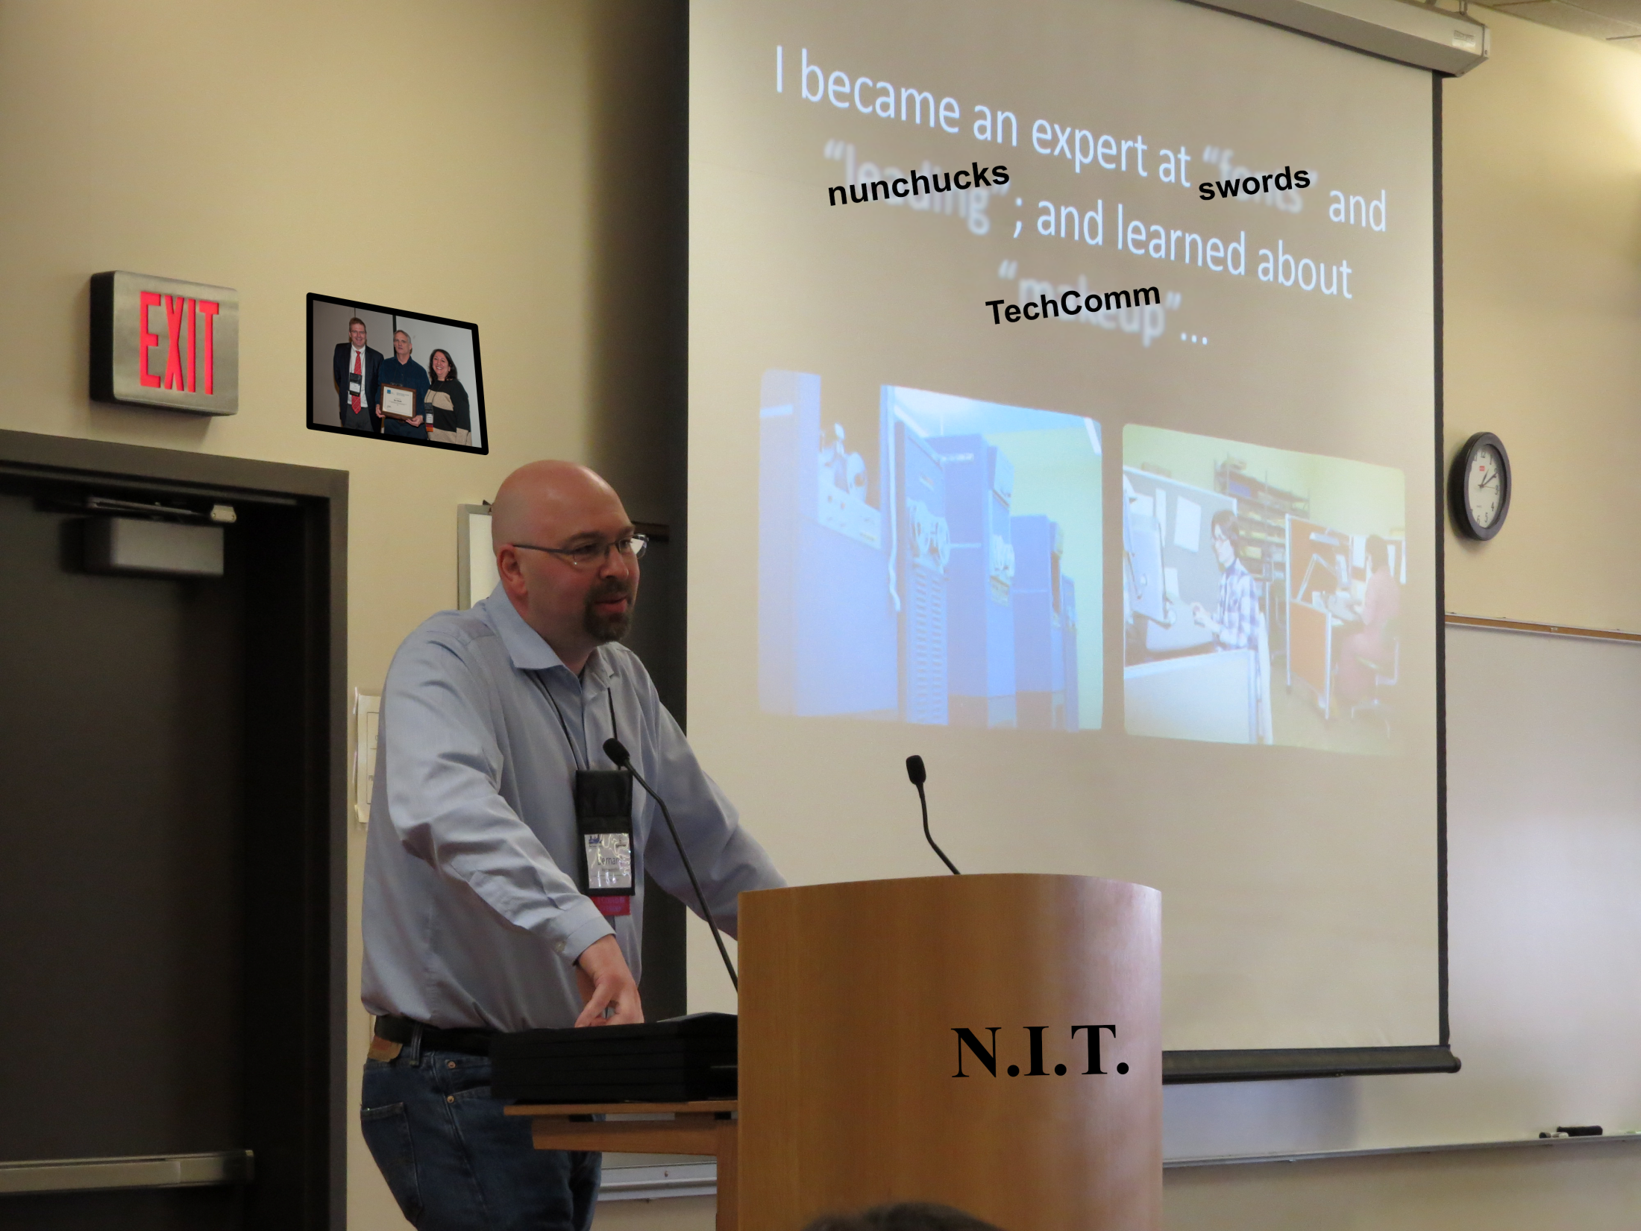

Ninja Institute of

Slide 6



Understanding
TechComm Ninjas

Slide 7




Slide 8





TechComm
Ninja!

Slide 9

What is a TechComm Ninja?

Slide 10
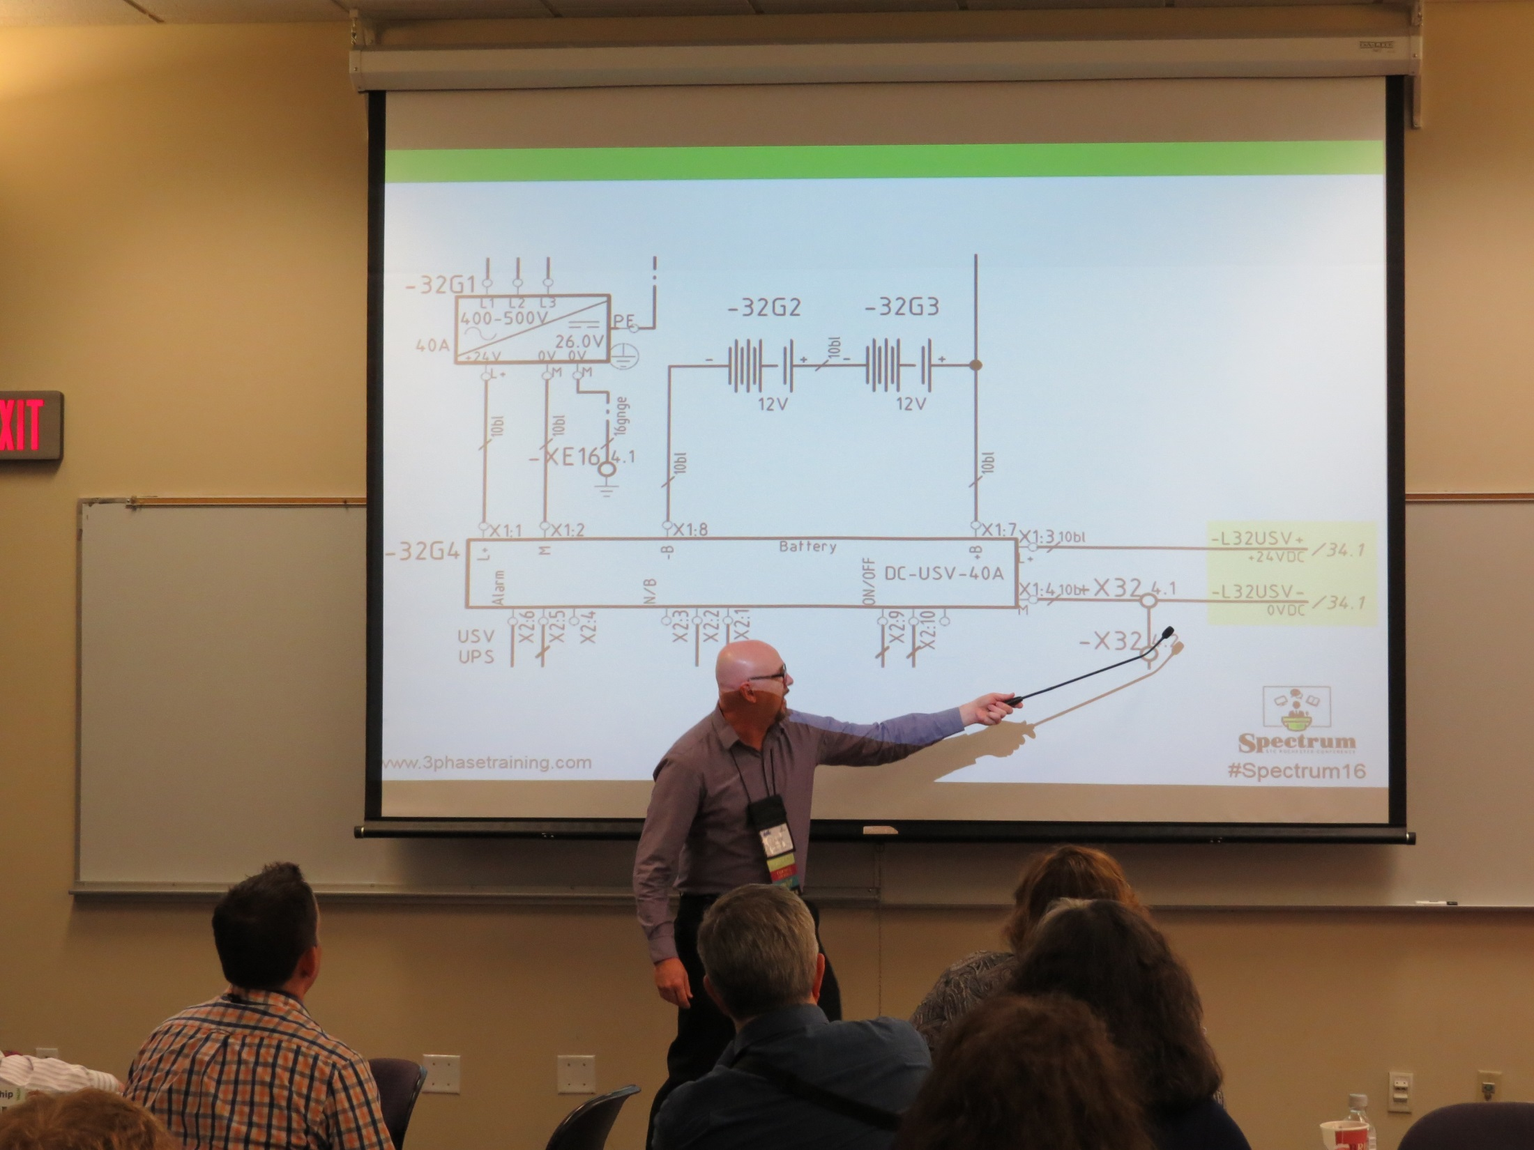



Analyzing TechComm Ninjas

Slide 11
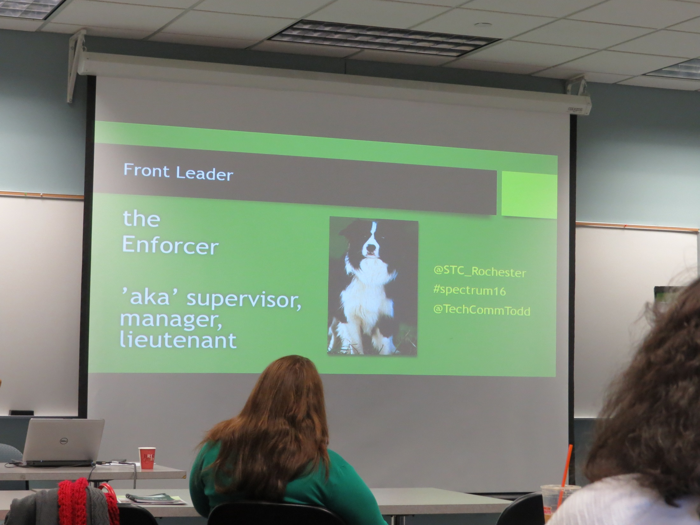


NINJA

Slide 12








Slide 13




Learn how to become
a TechComm
ninja.

Slide 14






Ninja TIP #9

Slide 15






Slide 16




Slide 17




Someday…

Slide 18
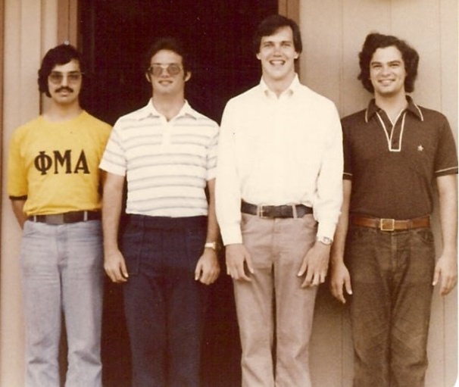




Slide 19
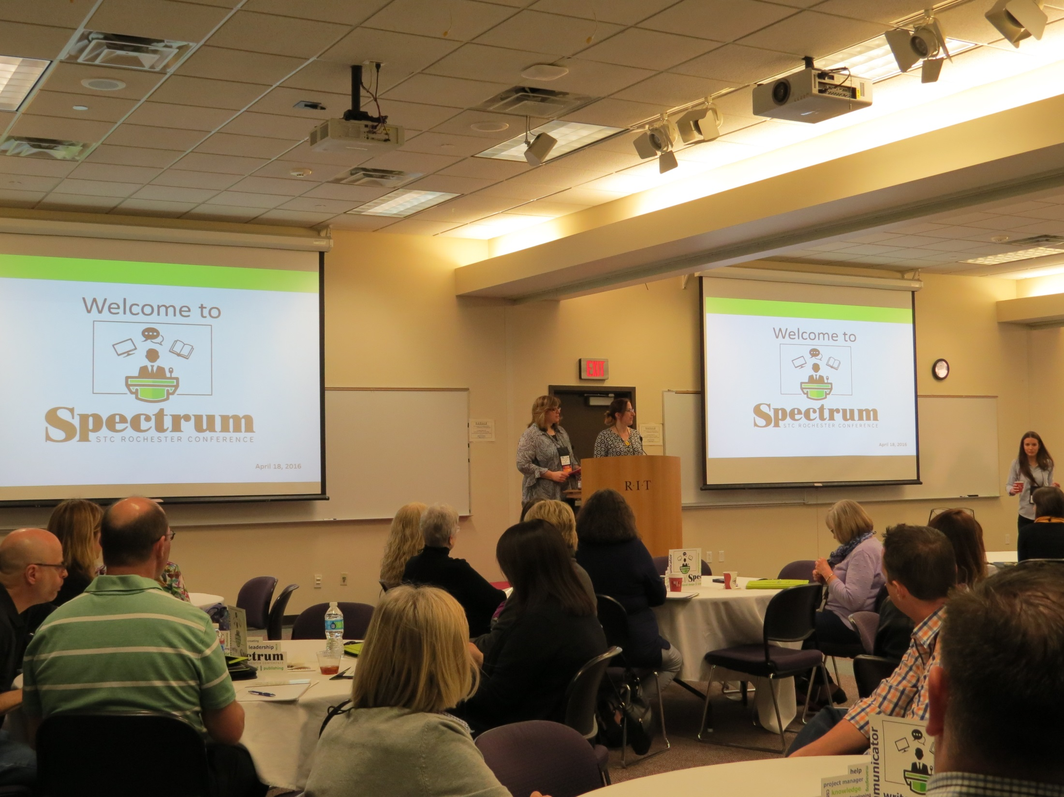




Slide 20



