Slide 1
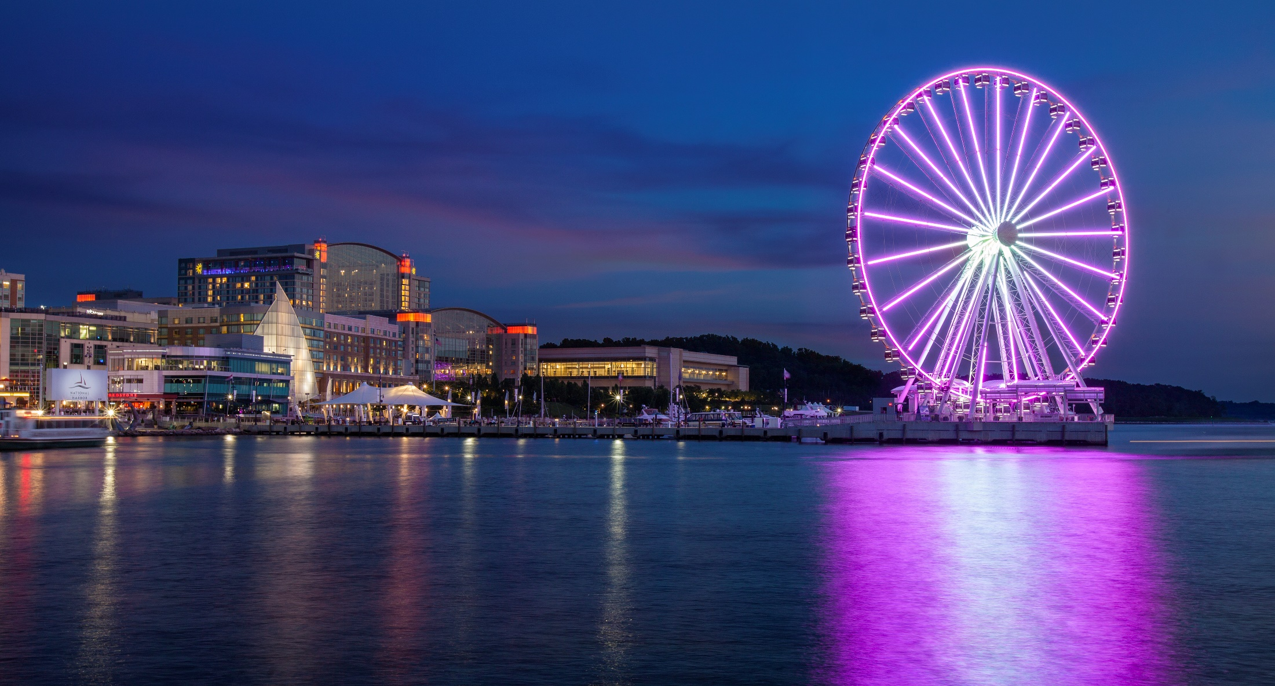
Welcome
IDL SIG Business Meeting May 9, 2017
Summit 2017
National Harbor, MD
#stc17

Slide 2
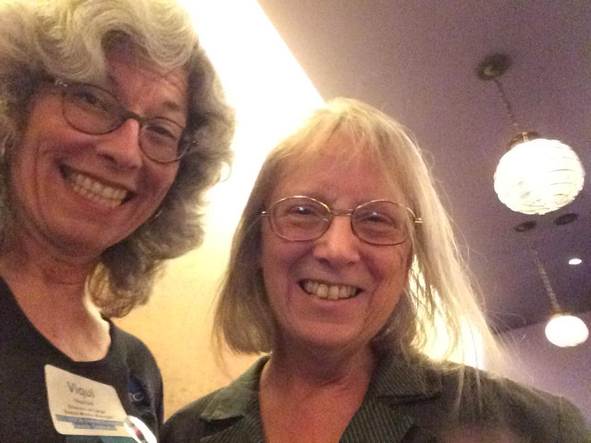
Welcome!
We’re glad you could join us today! Let’s look at who we are and at the great things our SIG has done over the past year!
Your co-managers,
Viqui Dill
Lori Meyer
Tweet us out at @stc_idl_sig
Visit us online at www.stcidlsig.org
Contact us at manager@stcidlsig.org
See us on Facebook at
#STCIDLSIG

Slide 3
Our Agenda
Welcome members and friends old and new!
The year in review:
Financial summary from our treasurer
Committee updates: Membership, Surveys, Social Media, Student Outreach, Mentoring, Programs, Newsletter, Web Site
Volunteer opportunities – we need YOUR superpowers!
Recognition and thanks – our community and our members
Wrap up

Slide 4
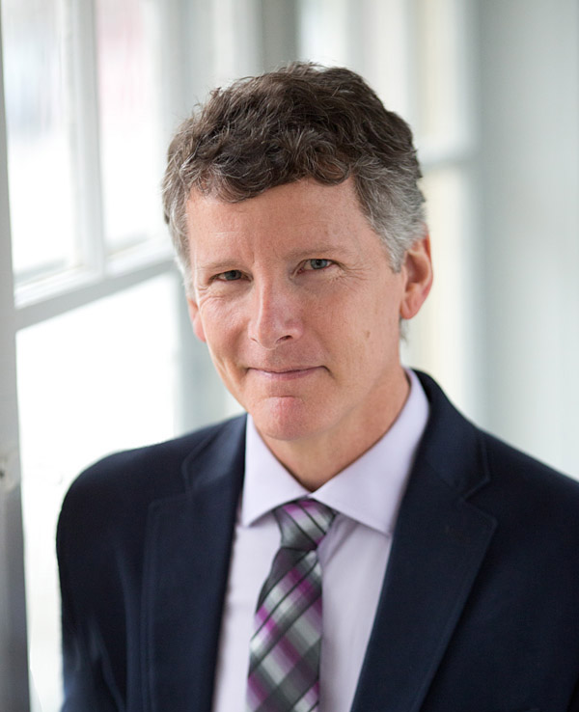
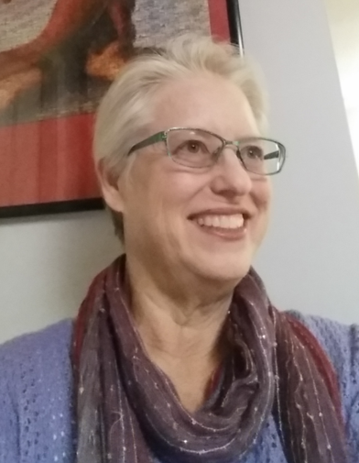
From our Treasurer
James Bousquet,
Treasurer,
2015-2017
Mellissa Ruryk,
Treasurer,
2017-

Slide 5
From our Treasurer
The SIG treasurer manages all financial transactions for the SIG, prepares the annual SIG budget, and provides guidance for best practices regarding SIG financial health.
Congratulations to James for being elected STC treasurer for 2017-2018!

Slide 6
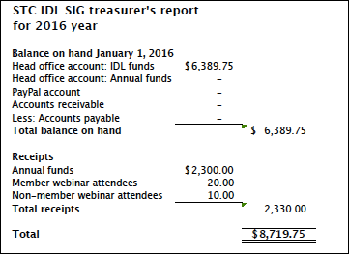
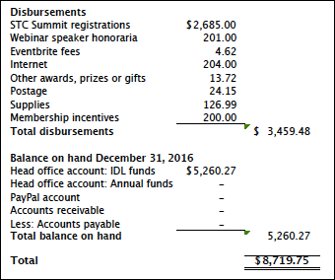
From our Treasurer
SIG financial report
For 2016

Slide 7
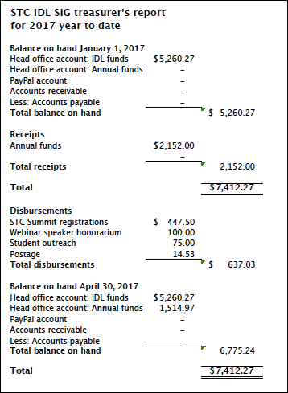
From our Treasurer
SIG financial report
For YTD 2017

Slide 8
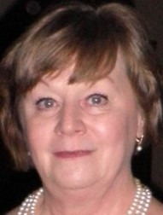
From our Secretary
My Secretary duties include taking and distributing the monthly meeting minutes, writing a column for the quarterly newsletter, and volunteering whenever I can.
Marcia Shannon, IDL SIG Secretary

Slide 9
From our committees
Membership
Surveys
Social Media
Mentoring
Programs
Newsletter
Web site
Student outreach

Slide 10
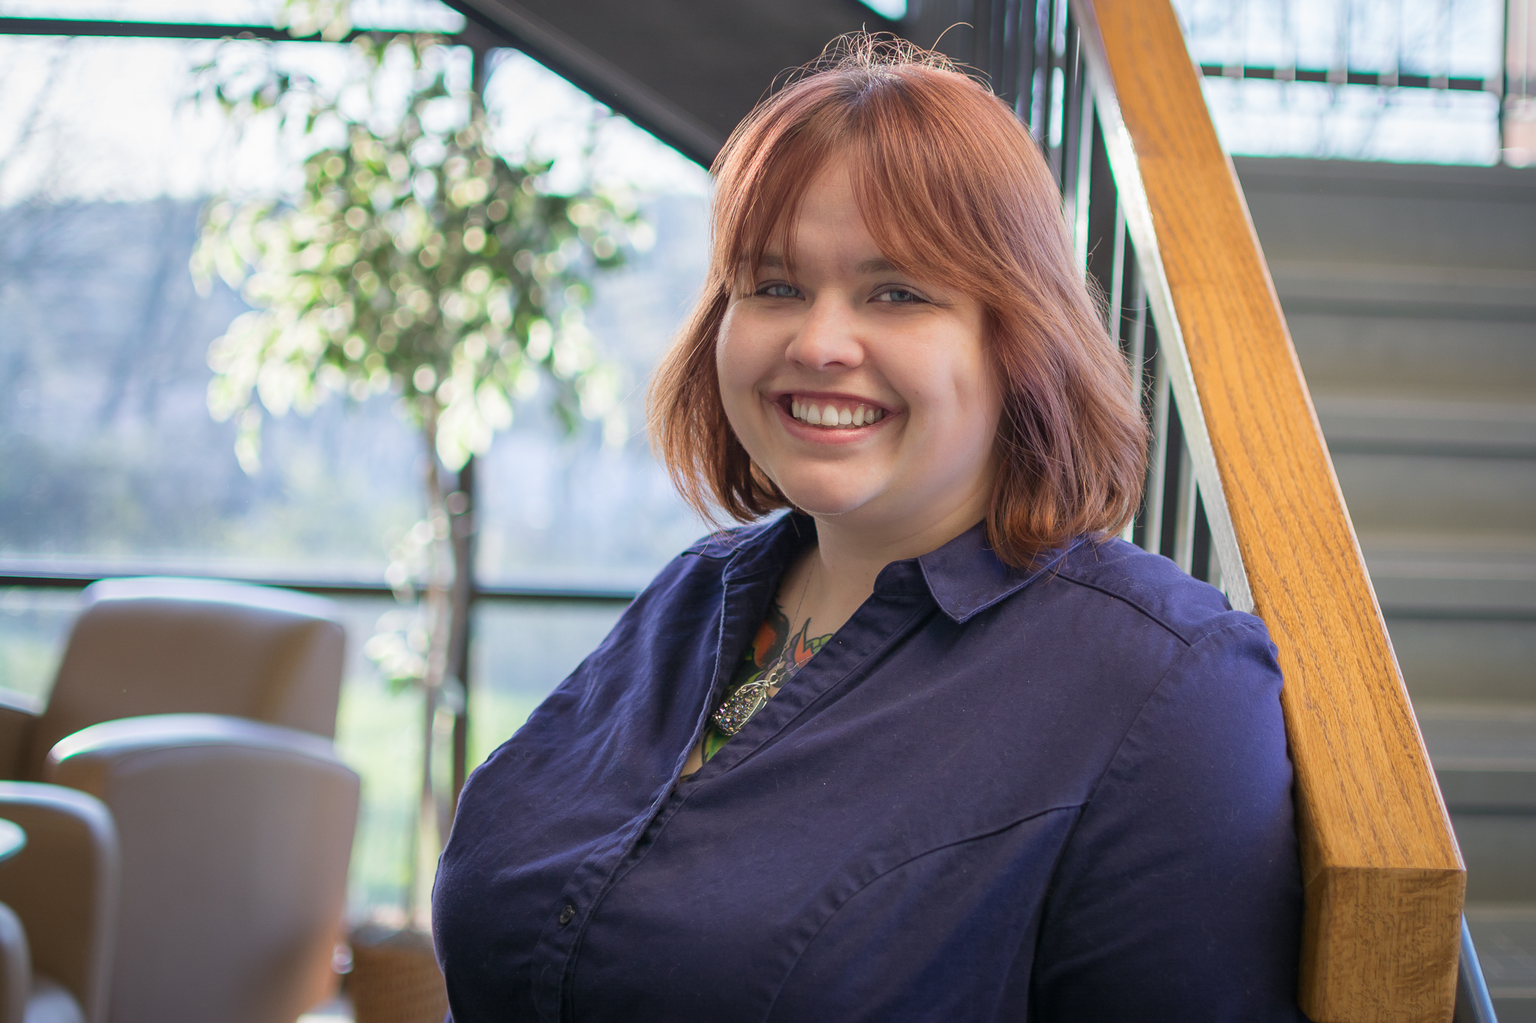
Membership
The membership manager:
Writes member spotlights in newsletter
Sends regular New member welcome emails
Follows up with members who did not renew
Canvasses members to apply for Associate Fellow and Fellow grades
Tweets and publicizes upcoming events
Sara Buchanan, membership manager

Slide 11
Membership report
We currently have 362 total members
64 new members since 01/01/2017
Our membership includes 20 Fellows, 10 Associate Fellows, and 121 Senior Members.

Slide 12
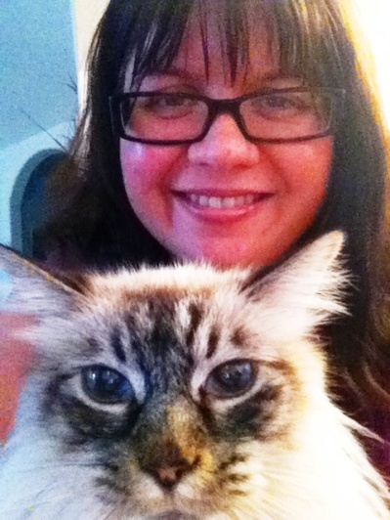
Social media/surveys
The social media manager maintains the SIG’s social media outlets, monitors and reports on activity, and publicizes SIG news and events through each outlet.
The surveys manager runs the SIG elections, conducts periodic surveys of members, analyzes results and publishes results to members.
Jamye Sagan, social media/surveys manager

Slide 13
Social media report
LinkedIn
359 members as of May 2017 (same as 2016)
Facebook
131 likes as of May 2017 (up from 89 likes in 2016)
Twitter (@STC_IDL_SIG)
97 following as of May 2017
419 followers as of May 2017 (up from 376 in 2016)
467 tweets as of May 2017 (not counting retweets and likes) (Up from 410 tweets in 2016)
When you tweet, use hashtag #STCIDLSIG

Slide 14
Surveys report
In 2016, we conducted a demographic survey of our members, and received close to 100 responses. We included a drawing for two Amazon gift certificates.
For a copy of the survey results, see http://www.stcidlsig.org/idl-sig-2016-membership-survey-results/. (Download the PDF)
We also held another successful Virtual Open House at the end of the year. We had more than 30 sign-ups.

Slide 15
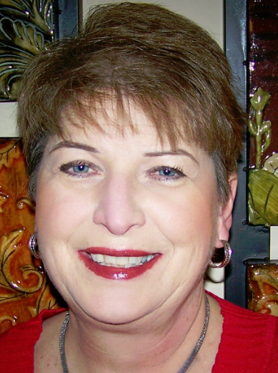
Student outreach
The Student Outreach manager works with students and educators to encourage student interest in instructional development and involvement in STC to prepare for instructional development careers.
Sylvia Miller,
STC Fellow
Student outreach manager

Slide 16
Student outreach report
Student Outreach Article competition:
In mid-summer we update handouts, submission materials, FAQs, and web site about the new iteration of the competition.
In late summer we notify universities with ID programs that the article competition is open. Notification includes links to all materials needed for participation in the competition.
We place submissions in our Dropbox account and ask judges to evaluate them.
We communicate with submitters—either congratulations or regrets—about their article.
We forward publish-worthy article(s) to our newsletter editor for publication and later to the TCBOK, if applicable.

Slide 17
Mentoring
The mentoring manager monitors the STC Mentor Board to find potential mentor/mentee matches, encourages SIG members to become mentors, and works with other STC communities and techcomm educators to foster interest in mentoring.
Scott McCoy,
Mentoring Manager

Slide 18
Mentoring report
In 2016, we had
45 mentors
241 mentees

Slide 19
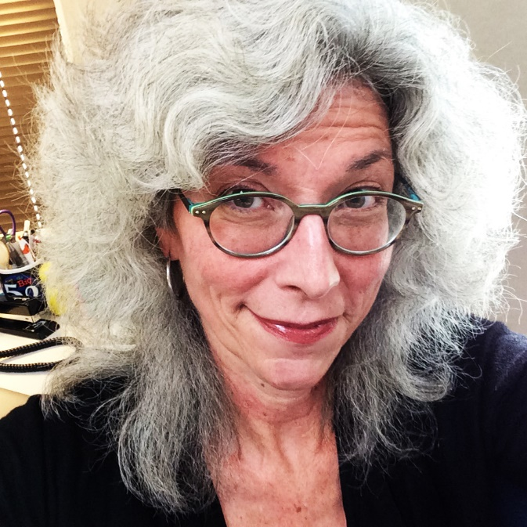
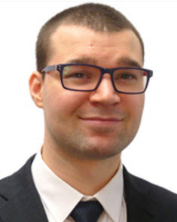
Programs
Viqui Dill
Program team leader, 2015-2017
Clayton Allenbright
Program team leader, 2017-

Slide 20
Programs report
Free recordings of past webinars for SIG members:
http://www.stcidlsig.org/membership/webinars/free-recordings-of-idl-sig-webinars-for-members/
Want to give a webinar? Want to attend a webinar on a specific topic? Contact manager@stcidlsig.org

Slide 21
Programs report
10 amazing webinars
Ask an Instructional Designer Clayton Allenbright and Jamye Sagan, 04/17/17
Test then Tell in eLearning Mary Whalen, 02/16/17
Virtual Open House, 11/16/16
Get a Move On! Animation Techniques in PowerPoint Robert Hershenow, 11/16/16
Want to give a webinar? Want to attend a webinar on a specific topic? Contact manager@stcidlsig.org

Slide 22
Programs report
10 amazing webinars (cont)
Helping Students Get Published Sylvia Miller Webinar through the STC Community Affairs Committee (CAC), 11/11/16
Student Outreach Article Competition Q&A Sylvia Miller, 10/20/16
#TechComm Showcase:
Editor as Collaborator. Lori Meyer and
Lessons My Cat Taught Me About ID , Jamye Sagan, 09/15/16
Want to give a webinar? Want to attend a webinar on a specific topic? Contact manager@stcidlsig.org

Slide 23
Programs report
10 amazing webinars (cont)
Lightning Talks webinar with Kit Brown-Hoekstra, Viqui Dill, Jamye Sagan, Mellissa Ruryk and Robert Hershenow, 08/18/16
My Career Reinvention: TW to IDL and Beyond Dr. Jackie Damrau, BPMN, 07/21/16
What I Would Have Liked to Know When I Started Out John Hedtke 06/16/16
Want to give a webinar? Want to attend a webinar on a specific topic? Contact manager@stcidlsig.org

Slide 24
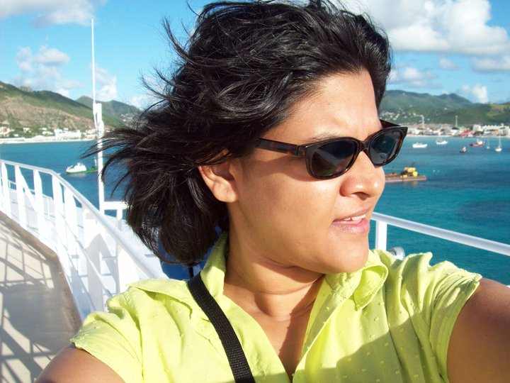
Newsletter
The newsletter editor manages all aspects of production for the SIG newsletter, including setting editorial schedules, soliciting content, working with co-managers to edit and finalize articles, and post each issue on the SIG web site.
Crista Mohammed
IDeaL Managing Editor

Slide 25
Newsletter report
Newsletter published for all quarters in 2016
Using available Google analytics from Viqui's reports:
Hits for April 2016 =91
Hits for May 2016 = 23
Hits for June 2016 = 55
Hits for July 2016 = 170
Hits for September 2016 = 64
Hits for October 2016 = 255
Hits for November 2016 = 53
Total hits for 7 months = 711 views, with an average of 102 views per month.

Slide 26
Newsletter report
Beginning Q1 of 2017, we have begun reaping in earnest the rewards of the student outreach essay competition: We published our first student essay ( by Leland Stoe) and we have more in the pipeline for publication.

Slide 27
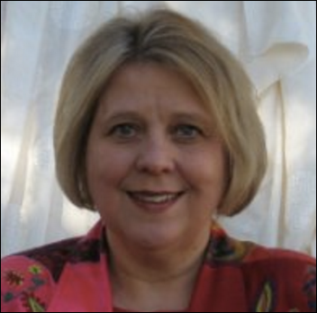
Web site
Viqui Dill
Web site manager,
2015-2017
Maralee Sautter
Web site manager,
2017-

Slide 28
Web site
The web site manager maintains the SIG web site (built on WordPress), encourages submission of content, assists content contributors, and works with STC to resolve technical issues and make improvements to the site.

Slide 29
Web site report
Hosted by STC
WordPress platform
http://www.stcidlsig.org/
We need web volunteers to help maintain our site!
Help is available
http://www.stcidlsig.org/about-idl-sig/volunteer-opportunities/getting-started-with-wordpress/

Slide 30
Volunteer opportunities
We need YOUR superpowers!
Program team members
Web site volunteers
Assistant SIG co-managers
Visit our web site to find out more!
http://www.stcidlsig.org/about-idl-sig/volunteer-opportunities /

Slide 31
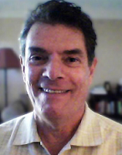
Recognition and thanks
First…MANY THANKS to our immediate past co-managers!
Mellissa Ruryk
Robert Hershenow
Under their leadership, our SIG has thrived over the last two years!

Slide 32
Recognition and thanks
Under Mellissa’s and Robert’s watch…
Our SIG newsletter, IDeaL, came back into production
We were recognized as a CAA Gold Community (2015) and a Platinum community (2016)
We instituted a Student Outreach program that is now starting its second year
We received an STC Pacesetter Award (2017)

Slide 33
Recognition and thanks
CAA Platinum Community
For fulfilling the STC mission of providing quality programs to members through innovative activities. For your outstanding work on leadership, transition, and community outreach.

Slide 34
Recognition and thanks
STC Pacesetter Award
For your innovative Article Writing Competition that encourages student participation with a unique two-level award system that benefits both the community and the Society.

Slide 35
Recognition and thanks
Distinguished SIG Service Award (DSSA)
Crista Mohammed
For your ingenuity and dedication in bringing the “IDeaL: Design for Learning” newsletter back to life in its online incarnation.

Slide 36
Recognition and thanks
Associate Fellows
Li-At Rathbun
For continually encouraging and mentoring technical communicators in best practices and professional development, and for ongoing support to STC communities in providing relevant programs to STC members.
Maralee Sautter
For enthusiastically promoting the value of technical communication within local and virtual communities, and personal leadership qualities that inspire the professional community and the next generation of technical communicators.
Ben Woelk
For passionate support and mentoring of STC leaders and members by modeling servant leadership and developing innovative solutions that strengthen STC communities.

Slide 37
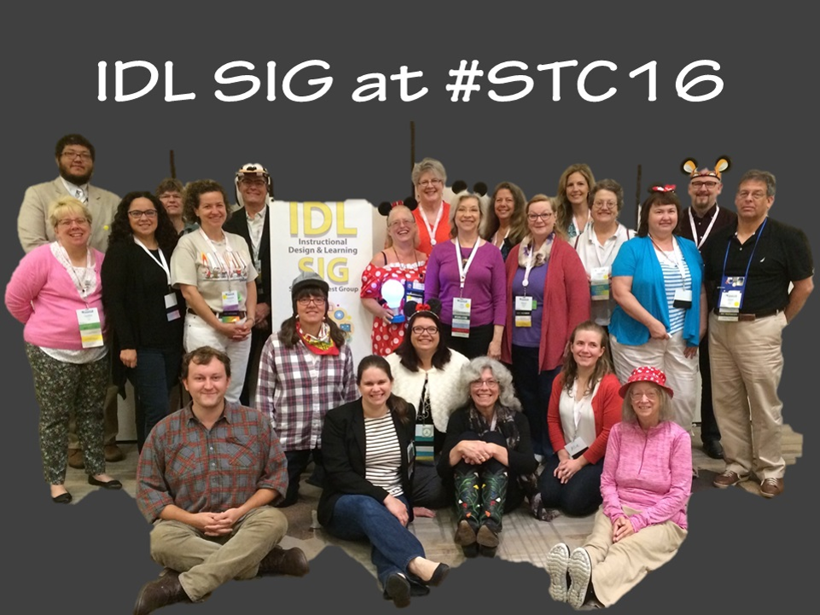
Wrap Up
Thank you for joining us today!
We’ll see you in Orlando, FL, May 2018!

