Slide 1
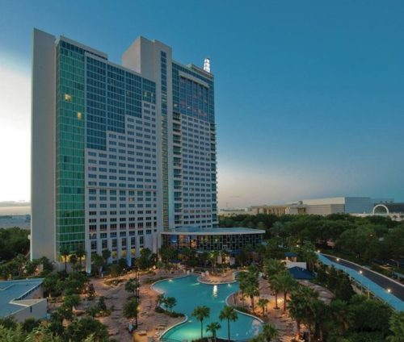
Welcome
IDL SIG Business Meeting
May 21, 2018
#stc18

Slide 2
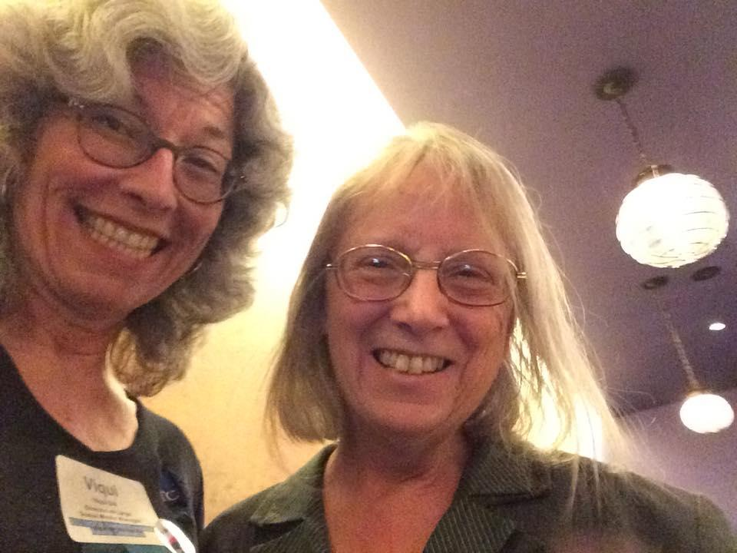
Welcome!
We’re glad you could join us today! Let’s look at who we are and at the great things our SIG has done over the past year!
Your co-managers,
Viqui Dill
Lori Meyer
Tweet us out at @stc_idl_sig
Visit us online at www.stcidlsig.org
Contact us at manager@stcidlsig.org
See us on Facebook at @STCIDLSIG https://www.facebook.com/STCIDLSIG/
#STCIDLSIG

Slide 3
Our Agenda
Welcome members and friends old and new!
The year in review:
Financial summary
Committee updates: Membership, Surveys, Social Media, Student Outreach, Mentoring, Programs, Newsletter, Web Site
Volunteer opportunities – we need YOUR superpowers!
Recognition and thanks – our community and our members
Wrap up

Slide 4
Financial update
The SIG treasurer manages all financial transactions for the SIG, prepares the annual SIG budget, and provides guidance for best practices regarding SIG financial health.
Would YOU like to be our next SIG Treasurer? Let us know!

Slide 5
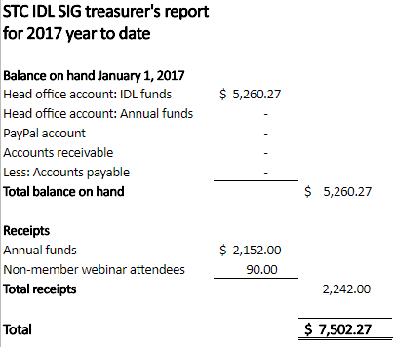
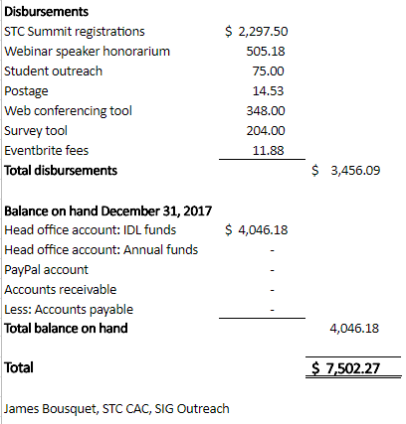
Financial update
SIG financial report
For 2017

Slide 6
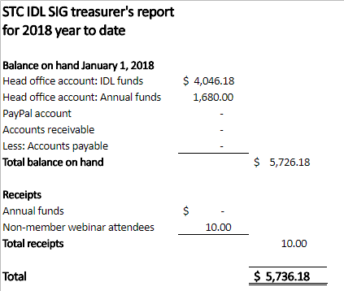
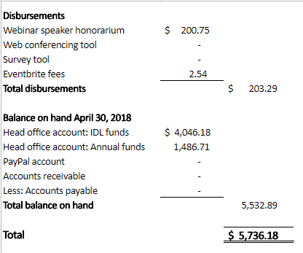
Financial update
SIG financial report
For YTD 2018

Slide 7
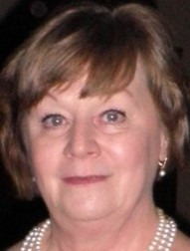
From our Secretary
My Secretary duties include taking and distributing the monthly meeting minutes, writing a column for the quarterly newsletter, and volunteering whenever I can.
Marcia Shannon, IDL SIG Secretary

Slide 8
From our committees
Membership
Surveys
Social Media
Mentoring
Programs
Newsletter
Web site
Student outreach

Slide 9
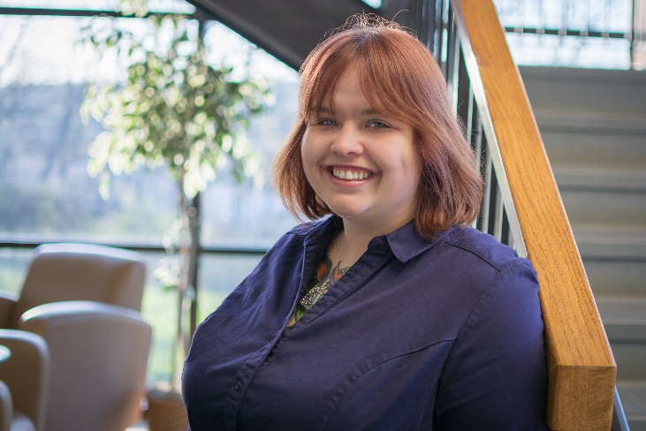
Membership
The membership manager:
Sends regular new member welcome emails
Follows up with members who did not renew
Canvasses members to apply for Associate Fellow and Fellow grades
Writes member spotlights in newsletter
Sara Buchanan, membership manager

Slide 10
Membership report
We currently have 387 total members
64 new members since 01/01/2018
Our membership includes 17 Fellows, 18 Associate Fellows, and 111 Senior Members.

Slide 11
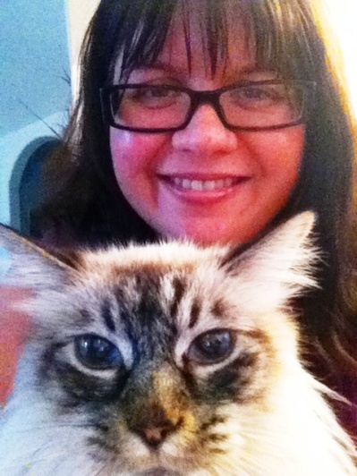
Social media/surveys
The social media manager maintains the SIG’s social media outlets, monitors and reports on activity, and publicizes SIG news and events through each outlet.
The surveys manager runs the SIG elections, conducts periodic surveys of members, analyzes results and publishes results to members.
Jamye Sagan, social media/surveys manager

Slide 12
Social media report
LinkedIn
362 members as of May 2018
Facebook
153 likes as of May 2018 (up from 149 likes in 2017)
Twitter (@STC_IDL_SIG)
103 following as of May 2018
461 followers as of May 2018 (up from 434 in 2017)
518 tweets as of May 2018 (not counting retweets and likes) (Up from 467 tweets in 2017)
When you tweet, use hashtag #STCIDLSIG

Slide 13
Surveys report
We held another successful Virtual Open House at the end of the year. We had more than 38 sign-ups with 25 views on YouTube https://youtu.be/nAxBKSJ9g_8.

Slide 14
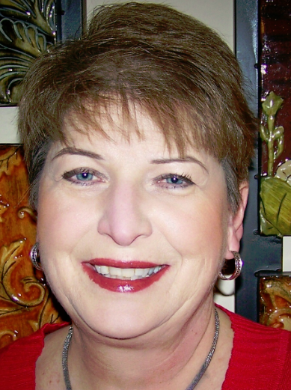
Student outreach
The Student Outreach manager works with students and educators to encourage student interest in instructional development and involvement in STC to prepare for instructional development careers.
Sylvia Miller,
STC Fellow
Student outreach manager

Slide 15
Student outreach report
Student Outreach Article competition:
In mid-summer we update handouts, submission materials, FAQs, and web site about the new iteration of the competition.
In late summer we notify universities with ID programs that the article competition is open. Notification includes links to all materials needed for participation in the competition.
We place submissions in our Dropbox account and ask judges to evaluate them.
We communicate with submitters—either congratulations or regrets—about their article.
We forward publish-worthy article(s) to our newsletter editor for publication and later to the TCBOK, if applicable.

Slide 16
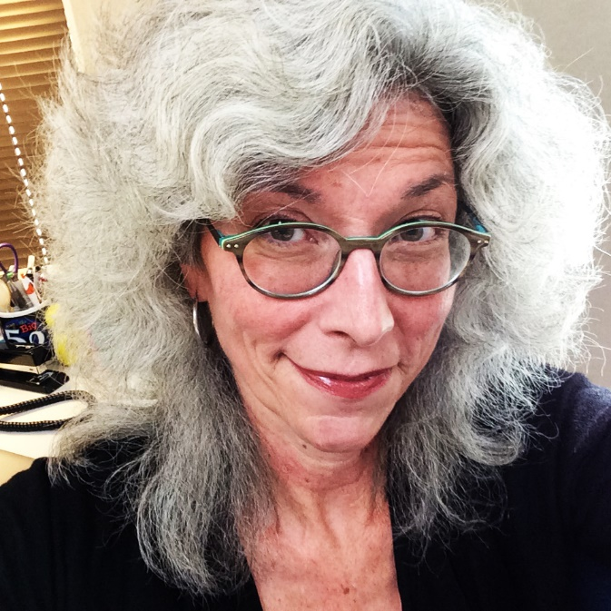
Programs
Viqui Dill
Program team leader, 2015-

Slide 17
Programs report
Free recordings of past webinars for SIG members:
http://www.stcidlsig.org/membership/webinars/free-recordings-of-idl-sig-webinars-for-members/
Want to give a webinar? Want to attend a webinar on a specific topic? Contact manager@stcidlsig.org

Slide 18
Programs report
9 amazing webinars in 2017-2018
Data Analytics Ed Marsh, March 15, 2018
Learning Styles and the Cancer Experience Debbie Kerr, January 18, 2018
Learning Environment Modeling Language Phylise Banner, December 7, 2017
Remembering Forward Allie Proff, November 16, 2017
Want to give a webinar? Want to attend a webinar on a specific topic? Contact manager@stcidlsig.org

Slide 19
Programs report
9 amazing webinars (cont)
Your Brain on PowerPoint Robert Hershenow, October 12, 2017
Create Presentation Handouts That People Will Actually Use Chuck Campbell, September 21, 2017
Digital Citizenship Phil Havlik, August 16, 2017
Ask an Instructional Designer Clayton Allenbright & Jamye Sagan, April 17, 2017
Want to give a webinar? Want to attend a webinar on a specific topic? Contact manager@stcidlsig.org

Slide 20
Programs report
9 amazing webinars (cont)
Test then Tell in eLearning Mary Whalen Sojoodi, February 16, 2017
YouTube recordings are private to IDL SIG members as a benefit of membership.
Public after a year for explorers and to promote the SIG.
Want to give a webinar? Want to attend a webinar on a specific topic? Contact manager@stcidlsig.org

Slide 21
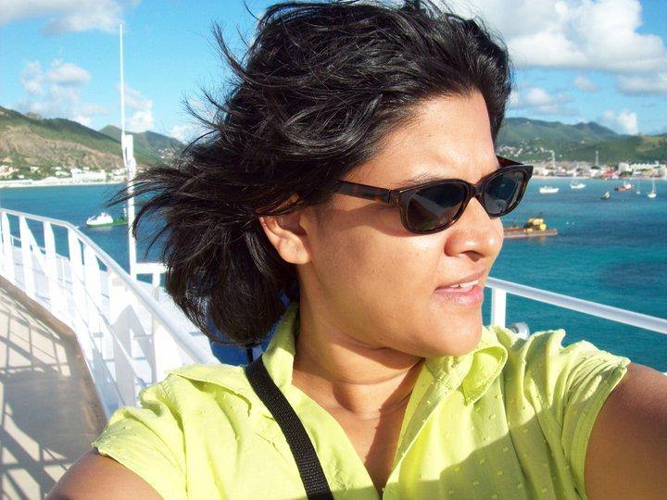
Newsletter
The newsletter editor manages all aspects of production for the SIG newsletter, including setting editorial schedules, soliciting content, working with co-managers to edit and finalize articles, and posting each issue on the SIG website.
Crista Mohammed
IDeaL Managing Editor, 2015-2018
Would YOU like to be our next newsletter editor? Let us know!

Slide 22
Newsletter report
Using available Google analytics from Viqui's reports
Total hits for 12 months = 1,003 views, with an average of 84 views per month.
April 17 46 | May 17 32 | June 17 70 | July 17 52
August 17 -- | September 17 285 | October 17 57 | November 17 41
December 17 27 | January 18 63 | February 18 123 | March 18 106
April 18 130

Slide 23
Newsletter report
Since Q1 of 2017, we have begun reaping in earnest the rewards of the student outreach essay competition
Here are links to student essays:
Leyland Stoe - “The Reluctant Learner” http://www.stcidlsig.org/engaging-the-reluctant-learner/
Whitney Lewis - “Rapid Prototyping” http://www.stcidlsig.org/rapid_prototyping/
Jessica Lynn Campbell, Alex Gurtis, Gabriel Latorre - “Technical Communicators’ Empowered with the User-centered Approach to ISD” http://www.stcidlsig.org/technical_communicators_instructional_system_design/
Maria Peter “Usability Standards for eLearning, Distributed Learning or Websites” http://www.stcidlsig.org/usability_standards_web_resources/

Slide 24
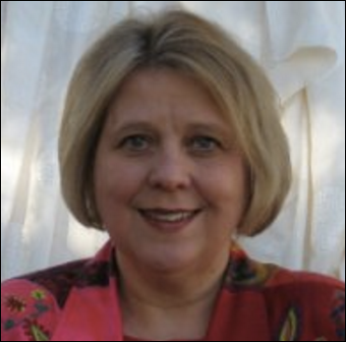
Web site
Maralee Sautter
Website manager,
2017-

Slide 25
Web site
The web site manager maintains the SIG website (built on WordPress), encourages submission of content, assists content contributors, and works with STC to resolve technical issues and make improvements to the site.

Slide 26
Web site report
Hosted by STC
WordPress platform
http://www.stcidlsig.org/
We need web volunteers to help maintain our site!
Help is available
http://www.stcidlsig.org/about-idl-sig/volunteer-opportunities/getting-started-with-wordpress/

Slide 27
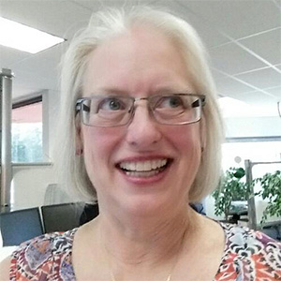
Content curator
As our content curator, Mellissa takes on the challenge of gathering and passing along knowledge about instructional design for publication on our website and newsletter, and then for submission to editors of the STC Body of Knowledge (TCBOK) database.
Mellissa Ruryk contentcurator@stcidlsig.org
Did you create or enjoy some great IDL related content? Let us know!

Slide 28
Training evaluations
Preeti served as Co-Manager for IDL-SIG 2012-2014. Preeti is an independent consultant and an STC Associate Fellow.
You can reach her at evaluations@stcidlsig.org.
Preeti Mathur, Training evaluations manager
Take advantage of this benefit of membership!

Slide 29
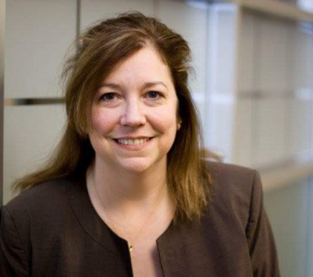
Communications / List Manager
Our community's main way of sharing Instructional Design and Learning information
Topics of discussion have included various tools, job openings, course development time estimates, online resources, and much more
Start a discussion by emailing idl-discuss@mailer.stc.org
Dr. Beth Bailey Communications / list manager
discussiongroups@stcidlsig.org

Slide 30
Volunteer opportunities
We need YOUR superpowers!
Treasurer
Newsletter editor
Web site volunteers
Assistant SIG co-managers
Visit our web site to find out more!
http://www.stcidlsig.org/about-idl-sig/volunteer-opportunities /

Slide 31
Recognition and thanks
CAA Platinum Community
For your dedication in promoting the technical communications profession by disseminating knowledge, sharing expertise, providing valuable programs, fostering leadership development, and performing student outreach.

Slide 32
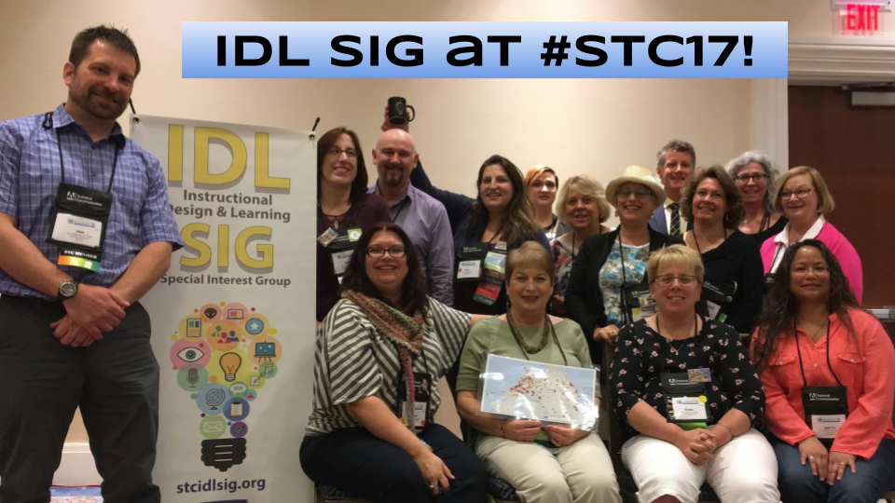
Wrap Up
Thank you for joining us today!
We’ll see you in Denver, CO, May 2019!

