Slide 1


Lights, camera, action
IDL SIG
Website for the Instructional Design and Learning Special Interest Group
Exploring Video Basics for Non-Production Professionals
STC IDL WEBINAR 8/13/18
Start: 11:30 am MDT
Please hold questions until the end.
D. Vigneault Beery, Asst. Professor Technical Writing
Stacy Barton, Asst. Professor Video Production
Metropolitan State University of Denver
Spring 2018

Slide 2

Lights, camera, action
Exploring Video Basics for Non-Production Professionals
D. Vigneault Beery, Asst. Professor Technical Writing
Stacy Barton, Asst. Professor Video Production
Metropolitan State University of Denver
Spring 2018

Slide 3

Generational origins
Generations have
  Fluid boundaries
  Diverse sources
  The ability to not ‘fit’
  Usefulness for broad understanding, not specifics
Corporate Video Basics
© STC IDL 2018

Slide 4
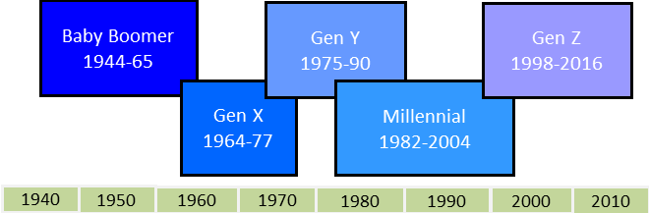
Generational origins
Corporate Video Basics
© STC IDL 2018

Slide 5
Generational preferences
& learning styles
preferences are grounded in
Formal educational patterns
Access to emerging technologies
Learning styles are
  Innate
  Mixed
  Changeable
  Expandable
Corporate Video Basics
© STC IDL 2018

Slide 6
Generational preferences
& learning styles
Corporate Video Basics
© STC IDL 2018

Slide 7
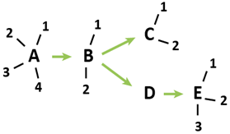
Generational preferences
& learning styles
Corporate Video Basics
© STC IDL 2018

Slide 8
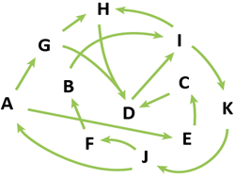
Generational preferences
& learning styles
Corporate Video Basics
© STC IDL 2018

Slide 9
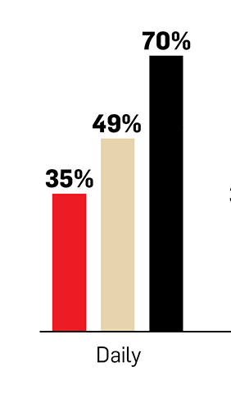
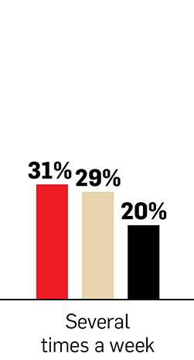




Corporate Video Basics
© STC IDL 2018

Slide 10
Video’S flexibility
Can be scaled
Can meet multiple learning styles
Corporate Video Basics
© STC IDL 2018

Slide 11
Corporate myths & roi
Myths
Too hard
Too expensive
Not necessary
Roi
Diverse measurements based on corporate need
Corporate Video Basics
© STC IDL 2018

Slide 12
Concept creation
WHAT NEED - a clear identification of the problem, process or policy to be addressed
WHO - an evaluation of the target audience(s), taking into account demographic factors
WHY - a clear objective is articulated to determine factors that can be measured for success
HOW – a roadmap of the big-picture content
WHAT CONTENT – the specific shots & dialogue and the basic production elements to successfully convey your vision to others
Corporate Video Basics
© STC IDL 2018

Slide 13
A/v script
_______________________________________________________________________________
INT. CONFERENCE ROOM-DAY
PEOPLE MILL ABOUT BEFORE A V/O PANEL CHAIR: If I could have presentation starts everyone’s Attention please …. let’s take our seats now, thank you.
CUT TO:
————————————————————————————————————————————
Corporate Video Basics
© STC IDL 2018

Slide 14

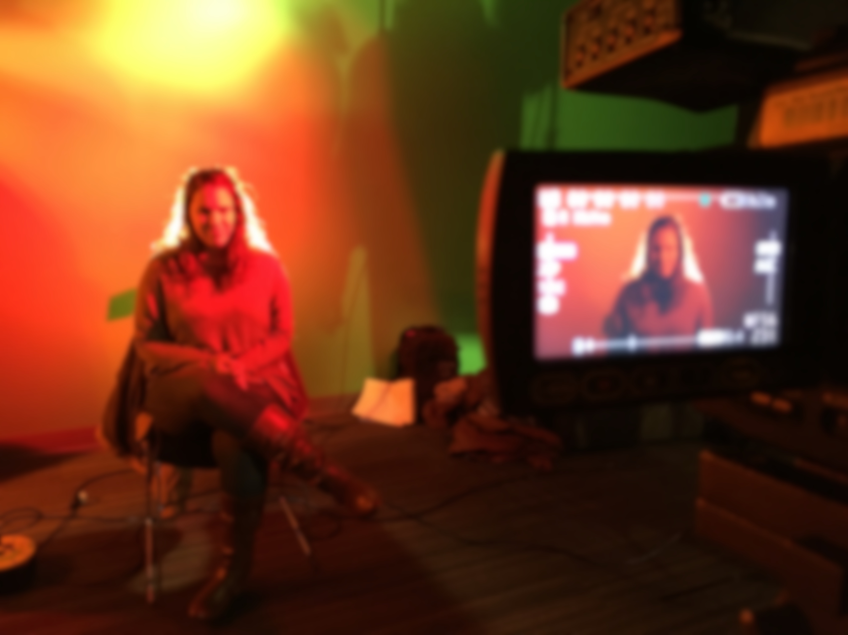
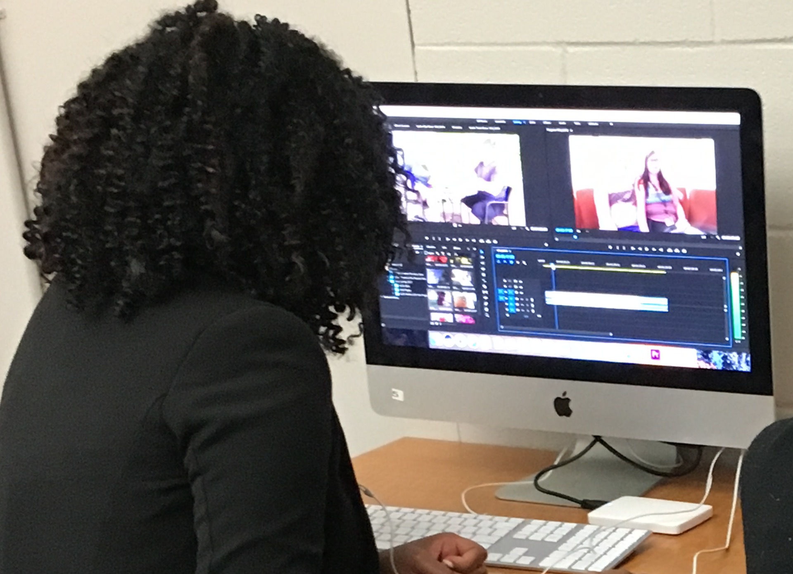
stages of video production
Writing
Pre-Production (Planning)
Production (Shooting)
Post-Production Editing (Sequencing)
Finishing (Soundtrack, Titles, Effects)
Distribution (Upload / DVD mastering)
Photos: Stacy Barton All Rights Reserved

Slide 15
In A/V writing, a script is created. setting, character, dialog, action are pieced together into cohesive whole. these choices dictate Production Workflow.
An A/V Script goes further to specify framing information like ‘shot size’ & camera movement, like ’pan’ or ‘tilt’.

Slide 16
Shot Planning requires pre-visualization
Gauging the most effective visual communication
“Seeing” the piece play out beforehand
Some questions to ask:
Is a large area around the on-screen subject needed to convey the message?
Long-Shot [LS] (full subject head to toe & some environment for context)

Slide 17
pre-visualization (continued)
will a closer shot of subject & their actions more clearly convey the message?
Medium-Shot [MS] (Waist up) for clear view of expression, gesture, & hands – gives sense of being in presence of subject
Medium-Close-Up [MCU] (Head & Shoulders) feels close & Intimate
Will a visual detail related to the content help to clarify a point, process, tool or product not sufficiently visible in wider shots?
Close-Up [CU] (Head only – very intimate, enlarged action )
extreme close-up [ECU] (very close and magnified)
cutaway (scene details revealing related objects or action)

Slide 18
casting the right on-screen talent to deliver the intended message is a crucial step in communicating effectively with the viewer.
Other pre-production tasks:
casting on-screen subjects

Slide 19
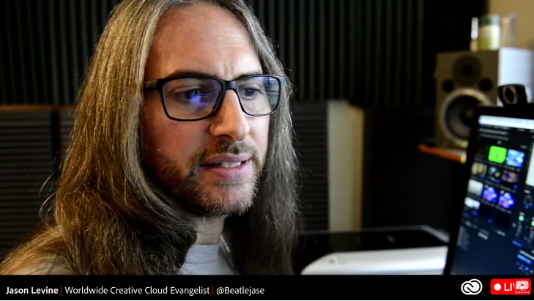
Sometimes the expert is the right person on-screen
Experts can confidently deliver information with integrity from an informed point-of-view.
“Adobe Jesus”, for example.
BUT….
what if they aren’t relatable?
What if they mumble?
What if they fidget on camera?
What if nerves prevent a confident performance & delivery?

Slide 20
effective on-screen communication is as much about Visual approachability and Aural clarity as it is about information delivery.
whether it’s a real person or an actor interfacing with the user, what’s most important is effective communication, however that can be achieved.

Slide 21
Other pre-production tasks: deciding on a shooting location
What Makes a Good Shooting Location?
  visually communicative & characteristic of the subject matter
  free of unauthorized trademarked logos
  sufficient electrical outlets to support production equipment requiring power
  acoustically isolated for clean dialog recording free of mechanical hum, Hard-surface echo, & sound interference Like airplanes, car & foot traffic
  Unlikely to be unexpectedly interrupted

Slide 22
outsourcing production of a short corporate video runs from $500 to $2,500. (SlateandMain.com) though Most charge ‘day rate’ rather than flat fee.
Although, It’s affordable nowadays to buy equipment & software to create high-quality, professional videos that consumers today expect, & to acquire technical know-how to do it yourself online.

Slide 23
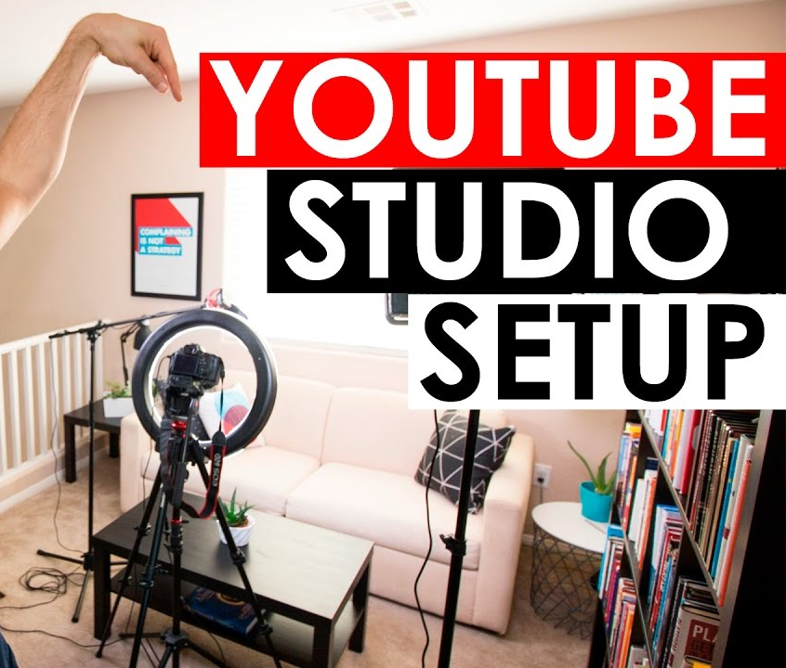
Video Production Equipment
Video Camera
Tripod
Lights & Reflectors (And / Or Available Light at Shooting Location)
Microphone & Mic Cable
Editing Software

Slide 24
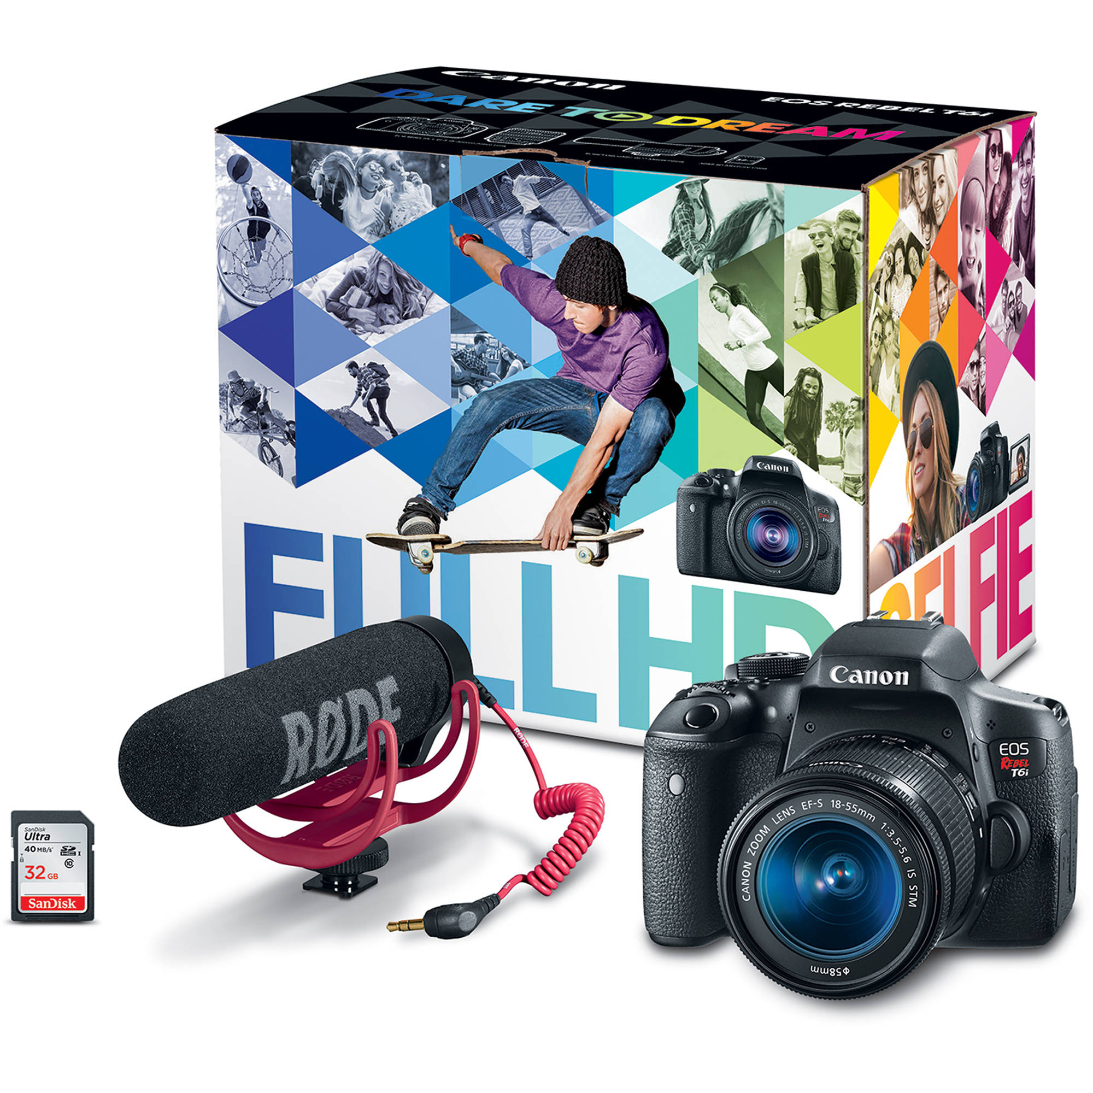
Video Camera
Considerations
Canon Rebel EOS T6i Video Creator Kit $999 bhphotovideo.com
All today record widescreen high-definition.
Consumer camcorders run $200-$500 but can be difficult to control & achieve pro results.
Prosumer Camcorders are good quality but can run approx. $1,000.
Professional Camcorders run $3,000 +.
DSLR (Canon, Nikon, Etc.) cameras take professional photos and HD video.
Popular Today, many ‘bundle’ options.
Canon’s ‘rebel’ Series - good value.
Interchangeable lenses mean different looks can be achieved (blurry background).

Slide 25
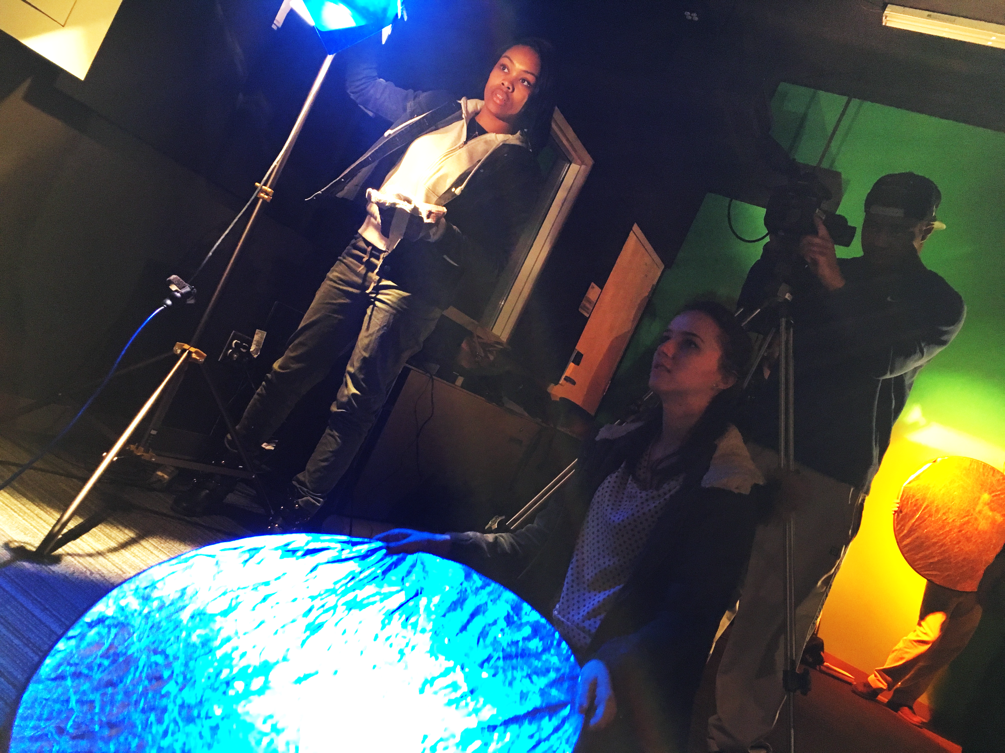
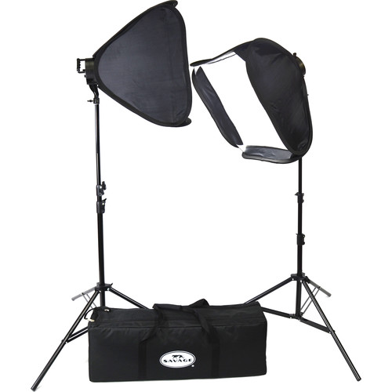
LED Lighting
Portrait 2-light kit
$250 BHPHOTOVIDEO.COM
Reflector
use w/ sun or available light
soft lighting is the most flattering
Achieve it by diffusing or bouncing light onto the subject

Slide 26
Shooting Considerations:
good composition:
headroom, rule-of-thirds, looking space
Good Coverage:
ensures all necessary dialog, action, angles, visual details are captured
clean audio recording – avoid bad sound pitfalls:
mic interference (rub or hiss), undesired sound- bleed, background hum, reverberation echo, mumbling

Slide 27
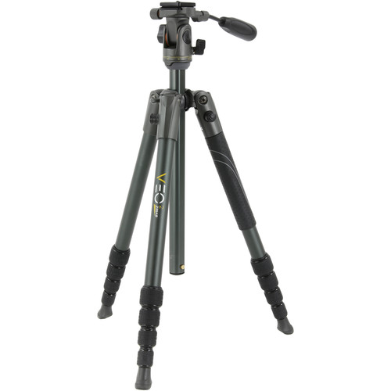
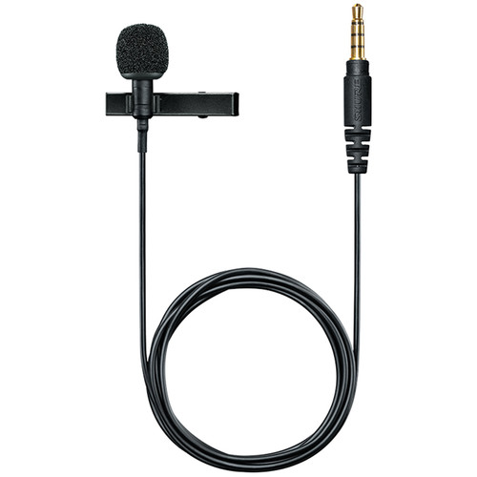
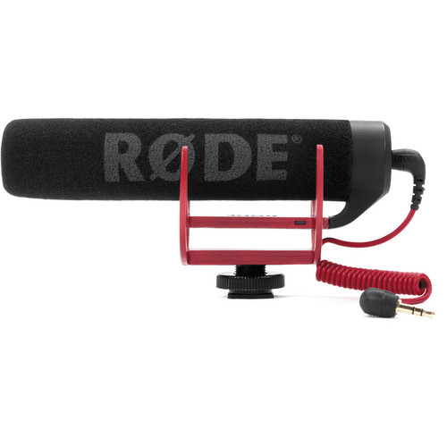
Tripod lavaliere mic – shotgun mic
$119 $69 $99
Bhphotovideo.com

Slide 28
Editing: combining shots together into a sequence.
Editing software is used to combine single video shots into full projects, adjust soundtrack, finish w/ titles & effects, export as finished product ready for upload online or to create dvd.
inexpensive to purchase, cheaper to lease (adobe creative cloud). free options are available. (YouTube, Quicktime PLAYER)

Slide 29
Other Tutorial Resources: Company websites, or through subscription sites like lynda.com.
free training via online tutorials accessed on youtube, WHERE IT’S FREE TO UPLOAD, AND CONVENIENT to ACCESS MILLIONS OF VIDEOS, INCLUDING informative TUTORIALS & DEMONSTRATIONS connecting consumers with Products & companies.

Slide 30

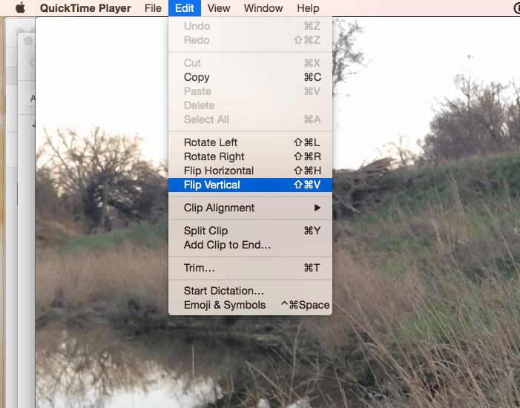
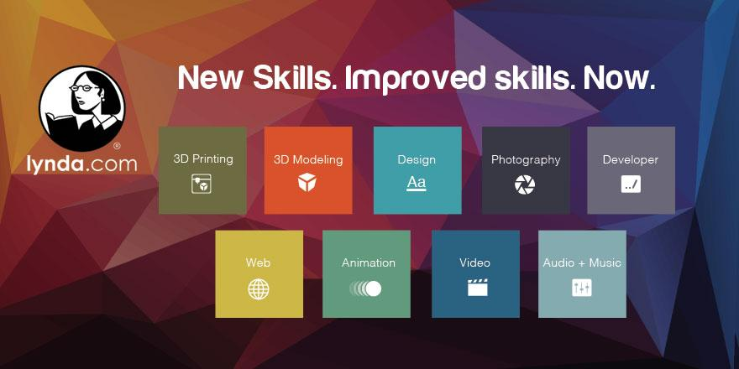
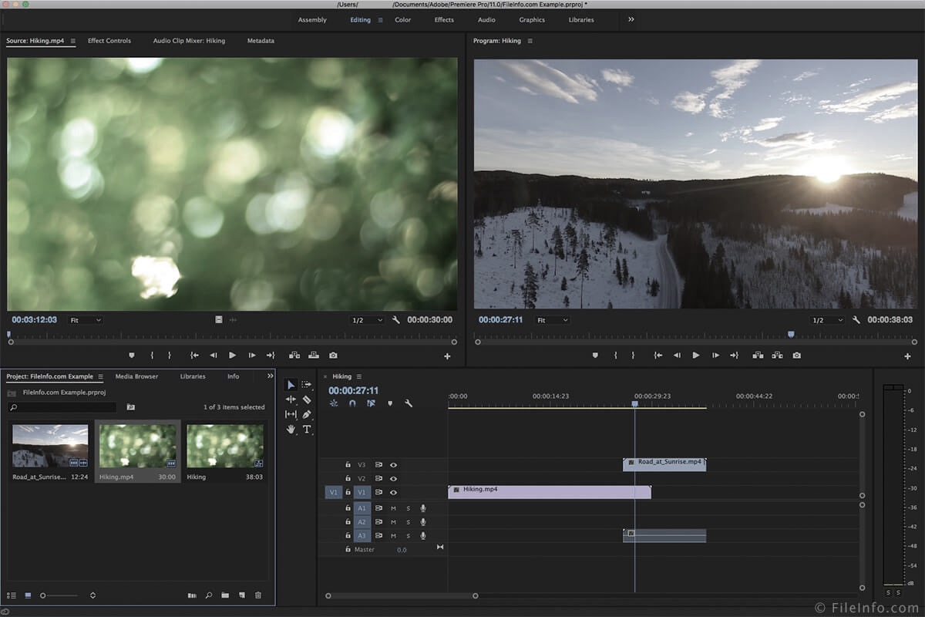

Slide 31
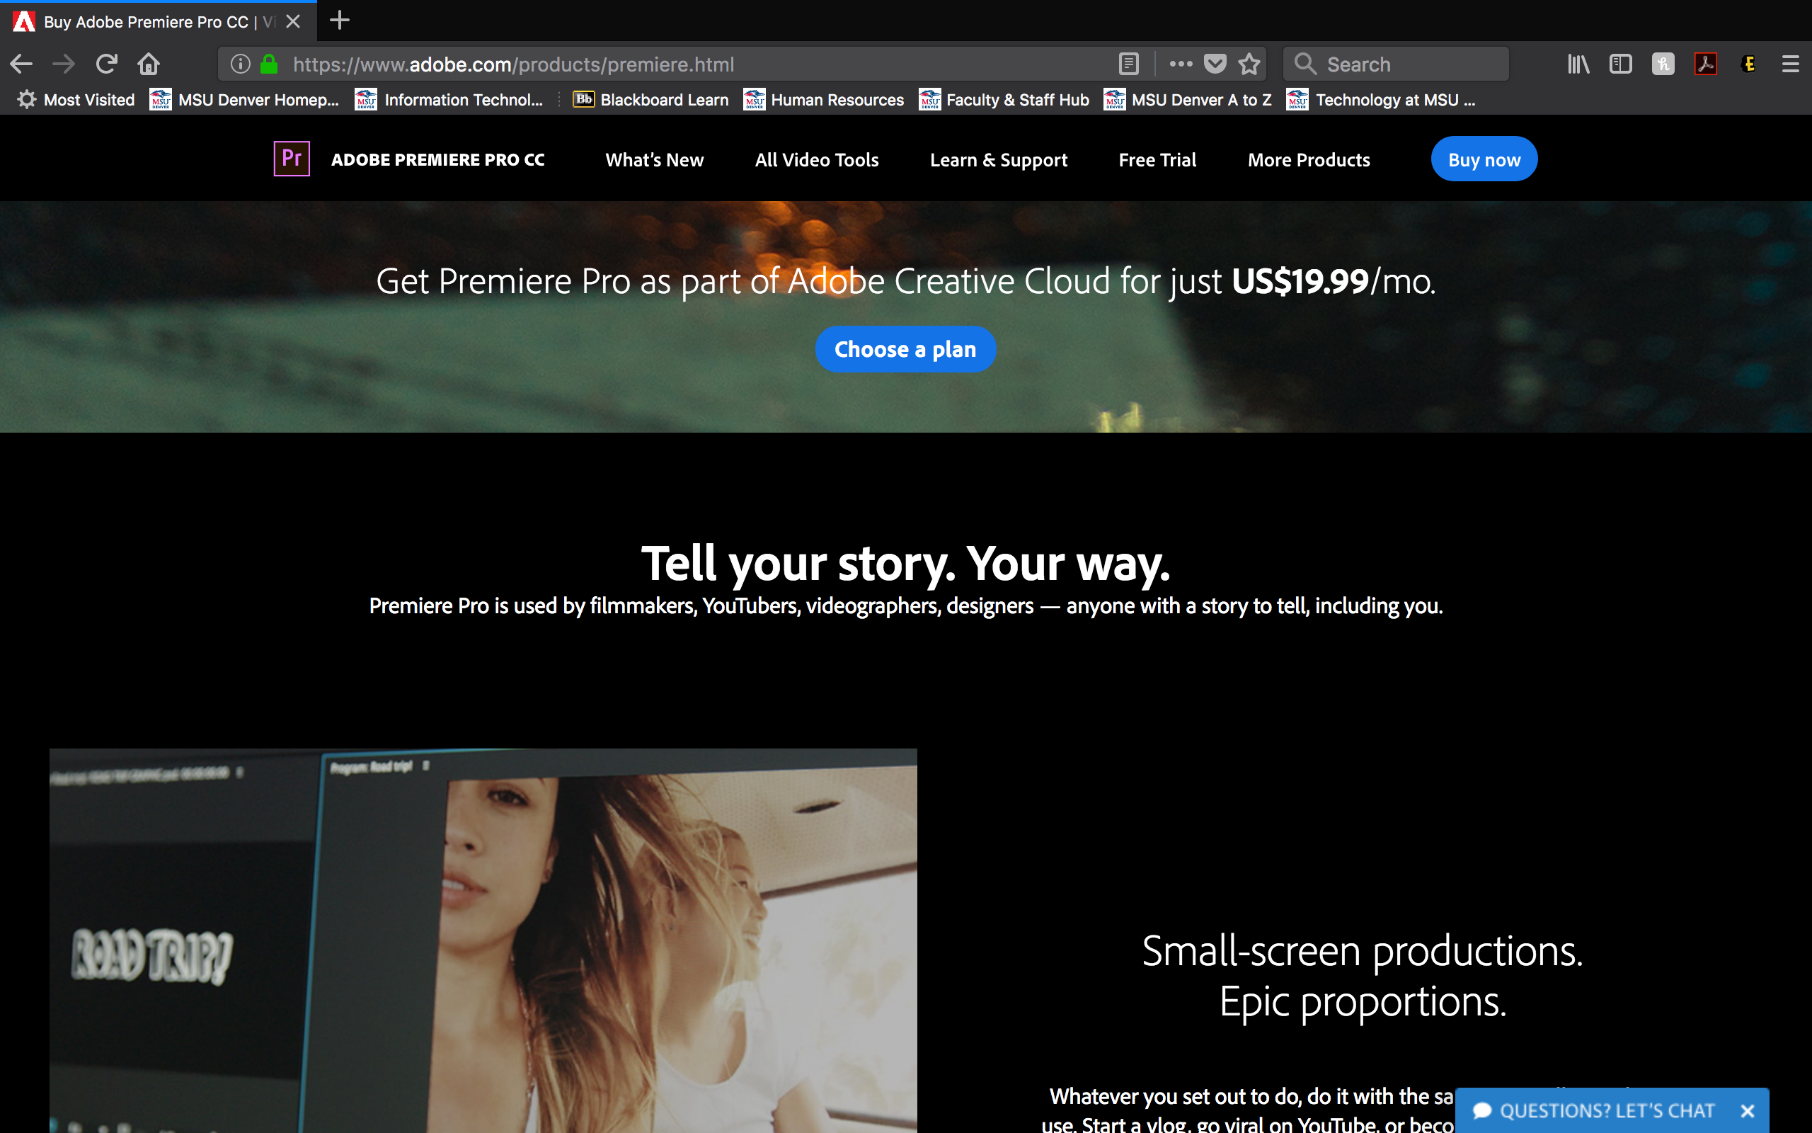

Slide 32
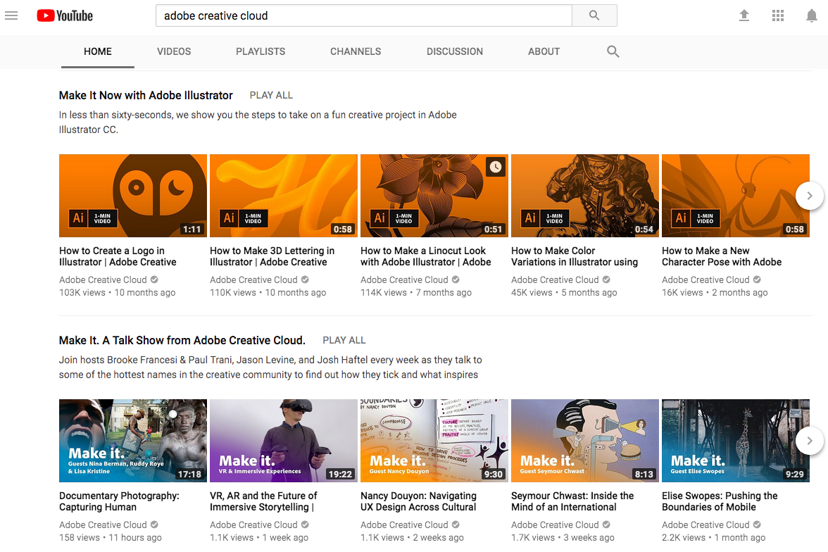

Slide 33
While rumors OF Hollywood STUDIOS hiring hundreds Of cast & crew and spending HUNDREDS OF MILLIONS to produce spectacles from our wildest dreams are definitely true…
in conclusion...

Slide 34
basic video production is a manageable step-by-step process that today can yield Effective results with relatively small investment;
ESPECIALLY WHEN COMPARED TO THE REACH POTENTIAL OF VIDEOs THROUGH FREE ONLINE PLATFORMS LIKE YOUTUBE….

Slide 35
Q&A
D. Vigneault Beery
Stacy barton
Asst. Professor
Technical Writing & editing
Metropolitan State University of Denver
Journalism & Technical Communication
Campus Box 35, P.O. Box 173362
Denver, CO 80217
303-615-0181
Asst. Professor
Video production
Metropolitan State University of Denver
Journalism & Technical Communication
campus Box 35, P.O. Box 173362
Denver, CO 80217
303-615-0118
Corporate Video Basics
© STC IDL 2018

Slide 36
Resources
Beery, Darcy. “Utilizing Classroom Diversity to Enhance Multi-Generational Learning.” (Proceedings, Hawaii International Conference on Arts & Humanities, 2018)
Advanogy.com. “Overview of Learning Styles”. learning-styles-online.com (2004). https://www.learning-styles-online.com/overview/
Warren, Linda. “Are Learning Differences between Generations A Myth?” MicroAssist.com (27 June 2012) https://www.microassist.com/learning-dispatch/arelearning-differences-between-generations-a-myth/
Nakano, Chelsi. “The Four Different Types of Learners, And What They Mean to Your Presentations [INFOGRAPHIC].” Prezi Blog (29 April 2016). https://blog.prezi.com/the-four-different-types-of-learners-and-what-they-mean-to-your-presentations-infographic/
Panopto. “Are You Ready to Support 4 Generations of Learners?” Panopto.com (5 May 2017). https://www.panopto.com/blog/are-you-ready-to-support-4-generations-of-learners/
Bazilian, Emma. “Infographic: How Gens X, Y and Z Consume Video Content.” Adweek (Feb. 2017) 12. http://www.adweek.com/tv-video/infographic-how-gens-x-y-and-z-consume-video-content/
Hoffman, Ari. “The Evolution of Tech Comm: Directing the Content Experience.” STC intercom: The Magazine of the Society for Technical Communication. 64.1 (January/February 2018) 6-8.
Friedmann, Anthony. Writing for Visual Media, Fourth ed. New York, NY Focal Press 2014
Corporate Video Basics
© STC IDL 2018

Slide 37
Resources
Adobe.com/CreativeCloud (April 19, 2018). https://www.adobe.com/creativecloud.html
BHPhotoVideo.com (April 19, 2018). https://www.bhphotovideo.com/
Helpx.adobe.com (April 19, 2018). https://helpx.adobe.com/in/support.html
LeVoir, Jake. “What Does the Average Video Cost?” SlateandMain.com (April 18, 2018). http://www.slateandmain.com/blog/what-does-the-average-video-cost
Lynda.com (April 19, 2018). https://www.lynda.com/
Shop.Canon.com (April 19. 2018). https://shop.usa.canon.com/shop/en/catalog/cameras/eos-cameras
YouTube.com (April 18, 2018). https://www.youtube.com/
Corporate Video Basics
© STC IDL 2018

