Slide 1

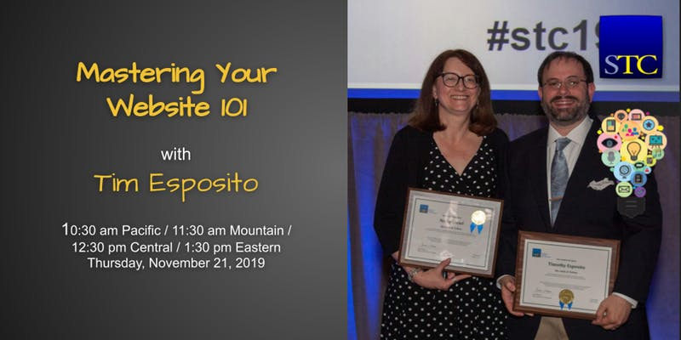
Mastering Your Website 101
The Basics of WordPress and cPanel

Slide 2

Introduction
STC Fellow
Society Level Work:
  Associate Fellow Committee Chair
  Summit Review Committee
  Former Community Achievement and Pacesetter Awards Committee Chair
  Community Affairs Committee Web Support
  Intercom Award Committee
  Scholarship Committee Member
  Book reviewer for Technical Communication
  Former Distinguished Community Service Award Committee Chair
  Former Budget Review Committee Member
Chapter Level Work – Philadelphia Metro Chapter
  Past President, VP, Treasurer, Acting Secretary, Webmaster, Scholarship Manager
Notes:
STC Fellow
Society Level Work:
Associate Fellow Committee Chair
Summit Review Committee
Former Community Achievement and Pacesetter Awards Committee Chair
Community Affairs Committee Web Support
Intercom Award Committee
Scholarship Committee Member
Book reviewer for Technical Communication
Former Distinguished Community Service Award Committee Chair
Former Budget Review Committee Member
Chapter Level Work – Philadelphia Metro Chapter
Past President, VP, Treasurer, Acting Secretary, Webmaster, Scholarship Manager

Slide 3
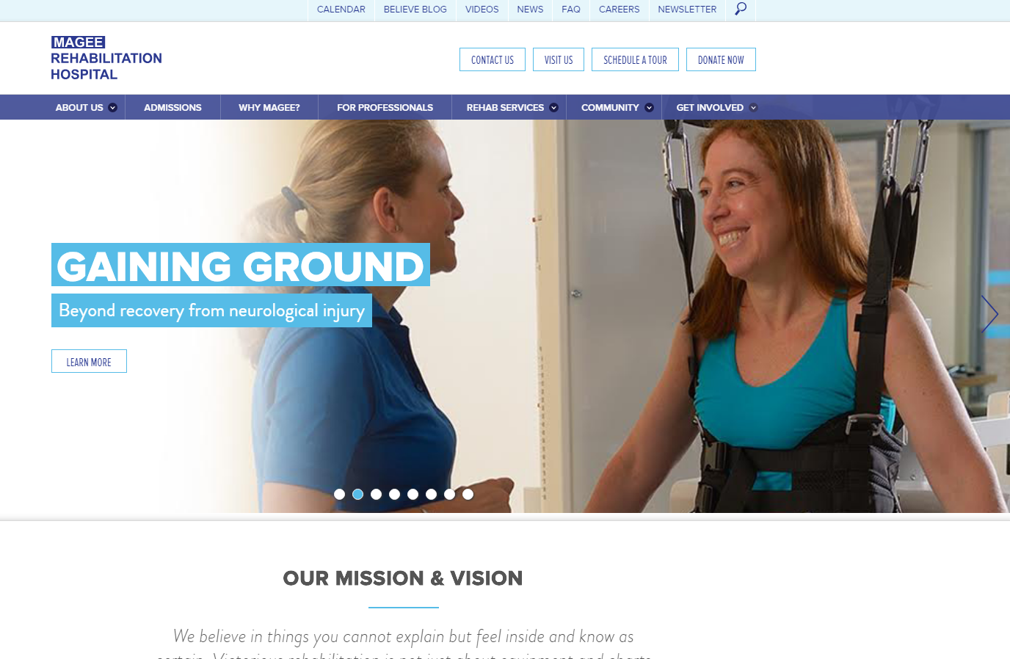
Experience
Taught myself HTML from an online guide in college
  Created silly college website which was a list of links
Landed paid webmaster internship with local hospital
  Just checked – they updated the website since I left in 1996
Took over the PMC website around 2012
CAC webmaster and web support since 2015
Notes:
Taught myself HTML from an online guide in college
Created silly college website which was a list of links
Landed paid webmaster internship with local hospital
Just checked – they updated the website since I left
in 1996
Took over the PMC website around 2012
CAC webmaster and web support since 2015

Slide 4
Intended Audience
People who are setting up a website for the first time.
People who want to learn WordPress and cPanel basics.
Notes:
People who are setting up a website for the first time.
People who want to learn WordPress and cPanel basics.

Slide 5
Overview
Establishing a Domain
1
Hosting the Content of the Domain
2
Creating Content on Your Hosted Domain (WordPress)
3
Customizations
Managing Website Background Details (cPanel)
4
Email Forwarders, Web File Management, Database Management
Notes:
Establishing a Domain
Hosting the Content of the Domain
Creating Content on Your Hosted Domain (WordPress)
Customizations
Managing Website Background Details (cPanel)
Email Forwarders, Web File Management, Database Management

Slide 6


Web domain registration
Where you define your URL, such as www.cac-stc.org
You are responsible to pay for and renew this domain
Some sites offer domain registration and hosting
Notes:
Where you define your URL, such as www.cac-stc.org
You are responsible to pay for and renew this domain
Some sites offer domain registration and hosting
Before you start creating your website content, you should register the name of the website. Formalizing a name, such as www.stc.org, is known as web domain registration. Many different companies offer domain registration; GoDaddy.com is one of the most recognized companies based on their Superbowl ads. On such a site, you pay to register a specific URL and make it your own. Some domain registration sites also offer domain hosting for a separate cost, but you are not obligated to use your domain registration site as your hosting company. Shop around and find the best deal that fits your future website’s needs as well as your annual budget.

Slide 7
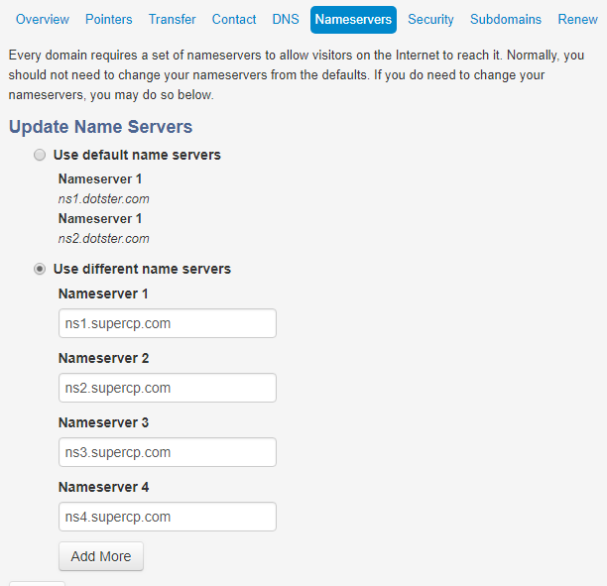
Web domain registration
Set the Name server for your hosting company
Tells your domain where to look for content
Notes:
After you register your domain URL, you need to tell the domain where your content will be stored. As noted above, this may be at the same company as where you registered, but it often is not. You configure where your domain will look for your website content by defining name servers. The name servers tell your domain registration service where your hosting company is located on the internet. When you set the name servers for your hosting company and you go to your domain’s URL, it directs all URL hits to go to the name servers indicated, and to look for a website there.

Slide 8
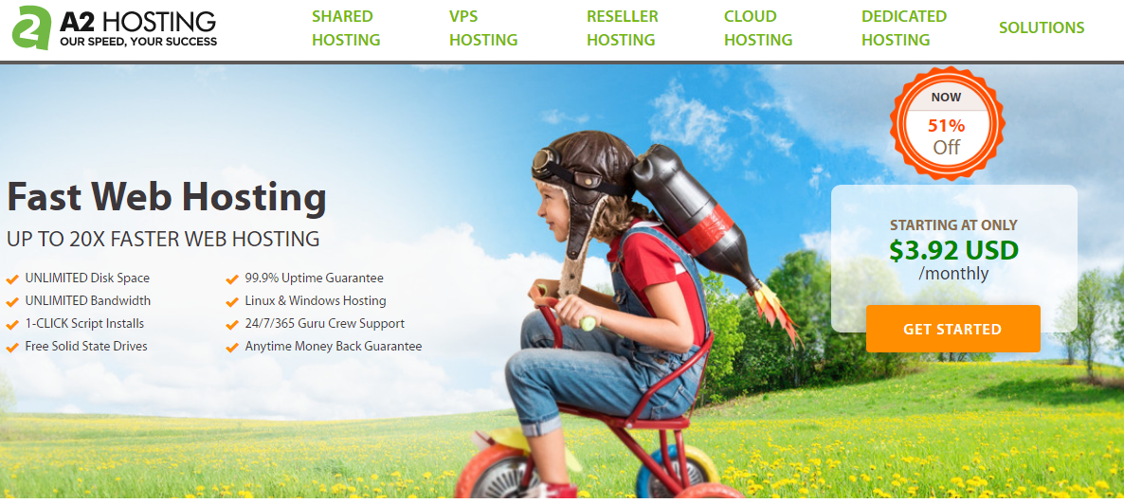
Web hosting
Notes:
Web hosts are where your content and files are stored. They control what servers hold your information and provide a toolkit to help run your website. Often, this toolkit is a package of utilities called cPanel, but each hosting company may offer more tools. You maintain complete control of your website and content, and these are the servers on which that information is stored.

Slide 9
A Tale of Two Wordpresses
There are two types of WordPress:
Not Hosted
Hosted
Not Hosted is free and has limited capabilities
https://tmesposit.wordpress.com/
Hosted requires that you register a domain and have a web host
That’s what you’ll be using
www.cac-stc.org
Notes:
Once you’ve registered a domain, picked a hosting company, and pointed the domain to that host, you’re ready to start with WordPress.
WordPress comes in two styles:
www.wordpress.com for their free blogging site.
www.wordpress.org for the software installed on your hosting site.
The hosted form from www.wordpress.org is more powerful. We will assume you are using that for the purposes of this article.

Slide 10
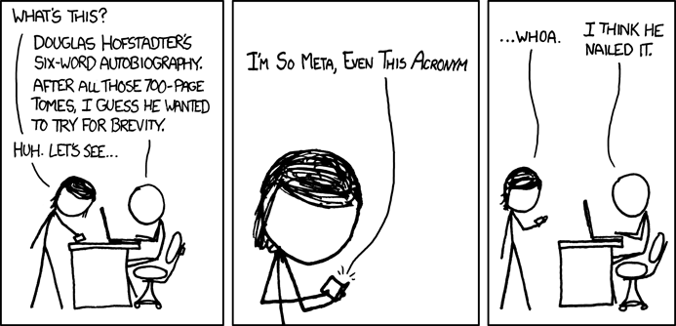
PHP
PHP: PHP Hypertext Processor
  PHP: Personal Home Page
https://xkcd.com/917/
Notes:
While you might create basic websites using HTML, WordPress uses a dynamic database, called PHP (a scripting language), to generate site content as needed. When opening a website written in PHP, the script is processed with data being pulled from a MySQL database, and then the page is rendered. This is different from an HTML-only website, where the pages are each stored as separate HTML files.
The name is self-referential, essentially “(Personal Home Page) Hypertext Processor”. You probably will not be editing any PHP, but you should be aware that the pages are not stored as HTML on your webserver. Therefore, do not expect to edit HTML web pages with Notepad.

Slide 11
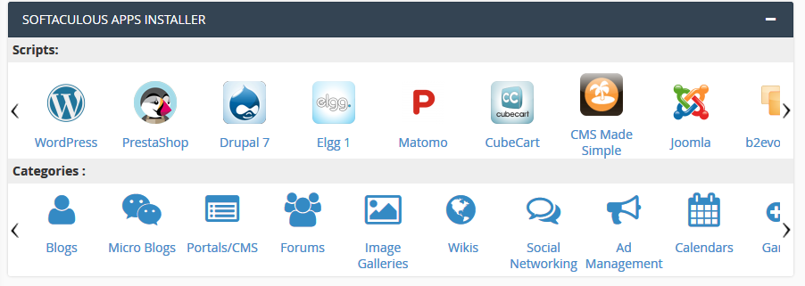
Installing WordPress
Notes:
If your hosting company does not set it up for you, you can install WordPress from the cPanel toolbox (more on that later). Alternatively, you can download installation files from www.wordpress.org, but it is easier to use cPanel’s Softaculous Apps Installer to install it.

Slide 12
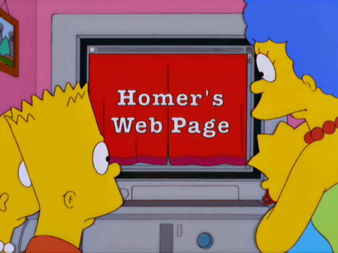
Creating Your Website
Notes:
With your domain registered, your hosting company established, and WordPress installed, you are set to create your website.

Slide 13

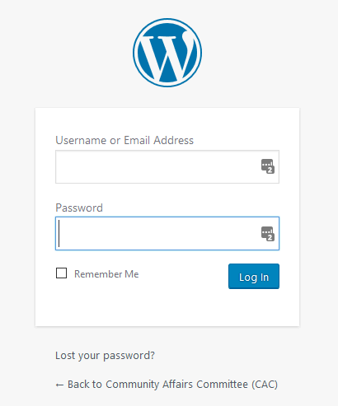
WordPress Login Page
https://www.example.com/wp-login.php
Notes:
Now you’re ready to create your content using WordPress. To sign into the dashboard of your website, go to your website, with /wp-login.php appended to the URL. For example, https://www.example.com/wp-login.php.

Slide 14
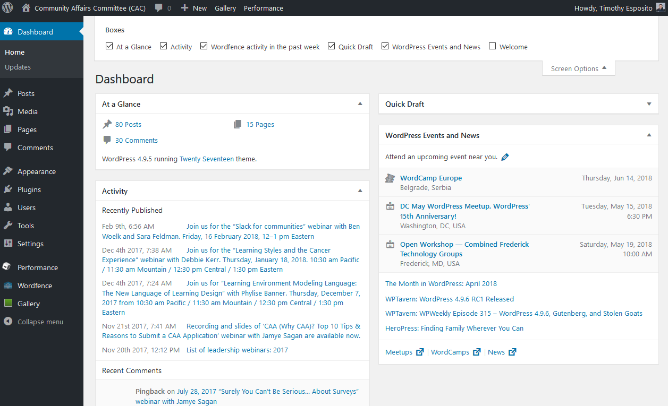
Dashboard
Notes:
Once you sign in, you’ll be taken to the Dashboard, which is the heart of the WordPress system. A menu appears on the left side of the Dashboard. Let’s go through each item in this menu.

Slide 15
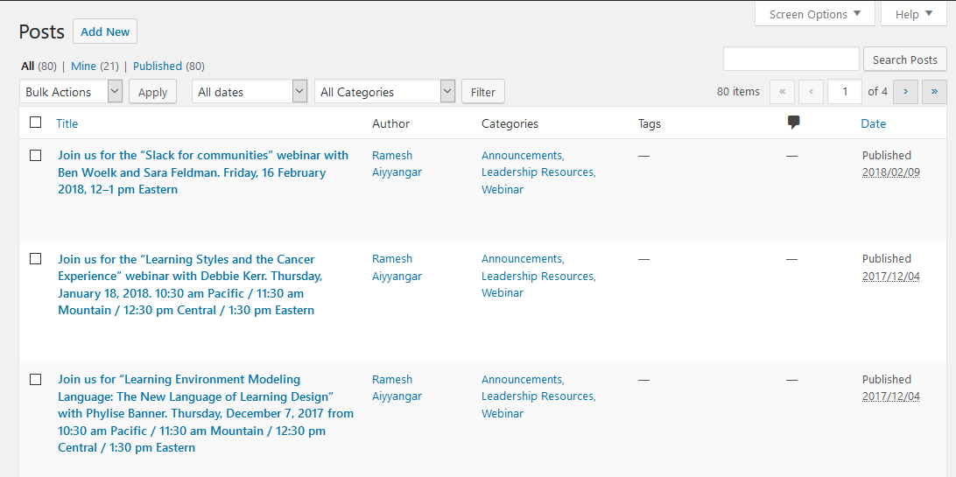
Posts
Notes:
“Posts” are the lifeblood of a WordPress site. They are timely updates pushed to feeds, such as the homepage, of your site. Examples include blog posts, event announcements, and newsletter articles.
Use “Categories” to sort and control in what feed the posts appear. Feeds are controlled through menus. You can set the main page to automatically be a feed, as a true blog would be.
Consider using “Tags” to further detail posts beyond the category. If you click on a tag in a post, all posts with that tag appear. For example, your category is Events, and each event post is tagged with a type of event: networking, educational, workshop.

Slide 16
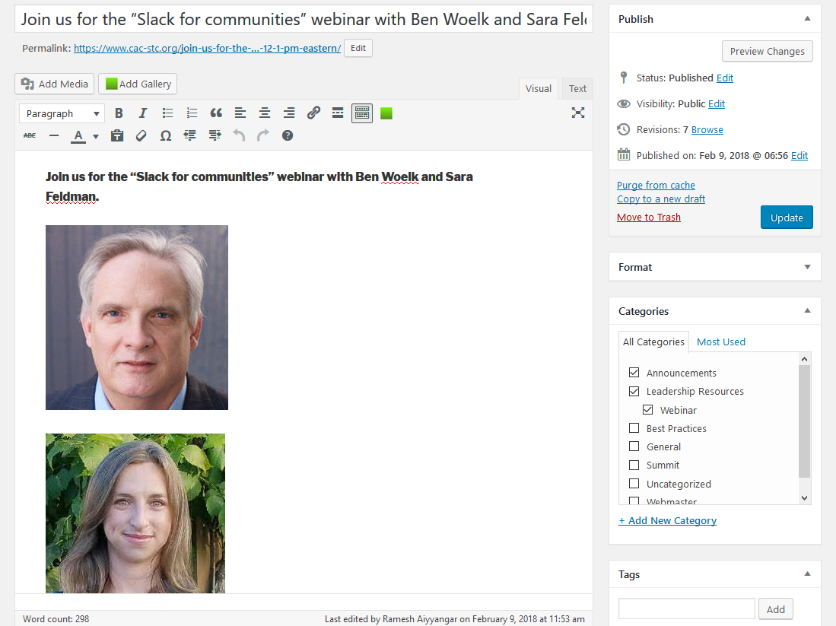
Posts - Editing
Notes:
When you edit a post using the WYSIWYG editor, you can see the published state, control the visibility, and see previous revisions. You can select Categories and add tags.

Slide 17
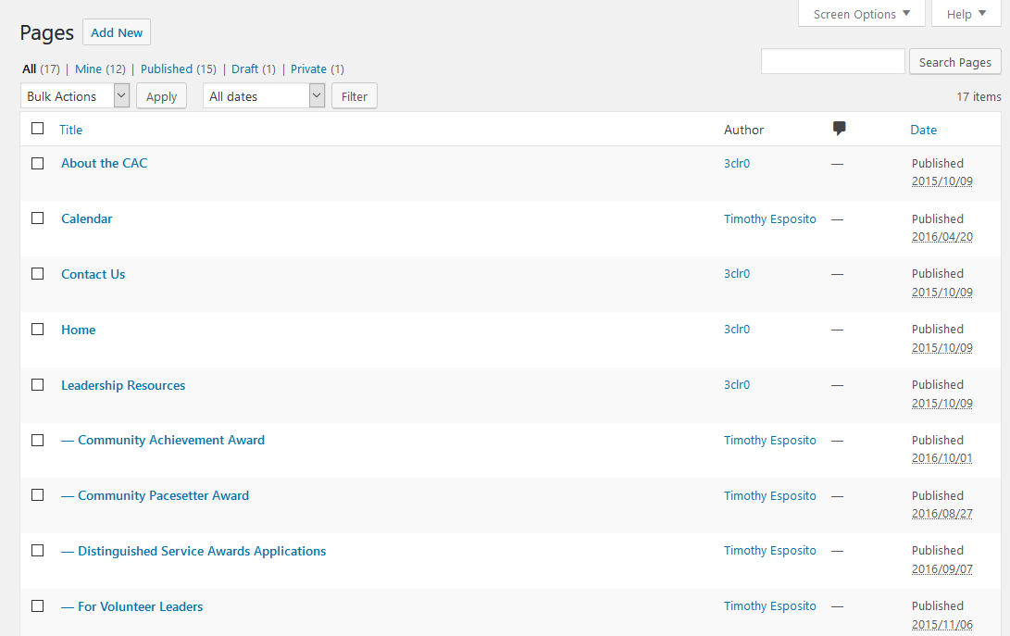
Pages
Notes:
Unlike Posts, Pages are for static content, and define your website’s structure. Pages can have a hierarchy reflected by indenting the title.

Slide 18
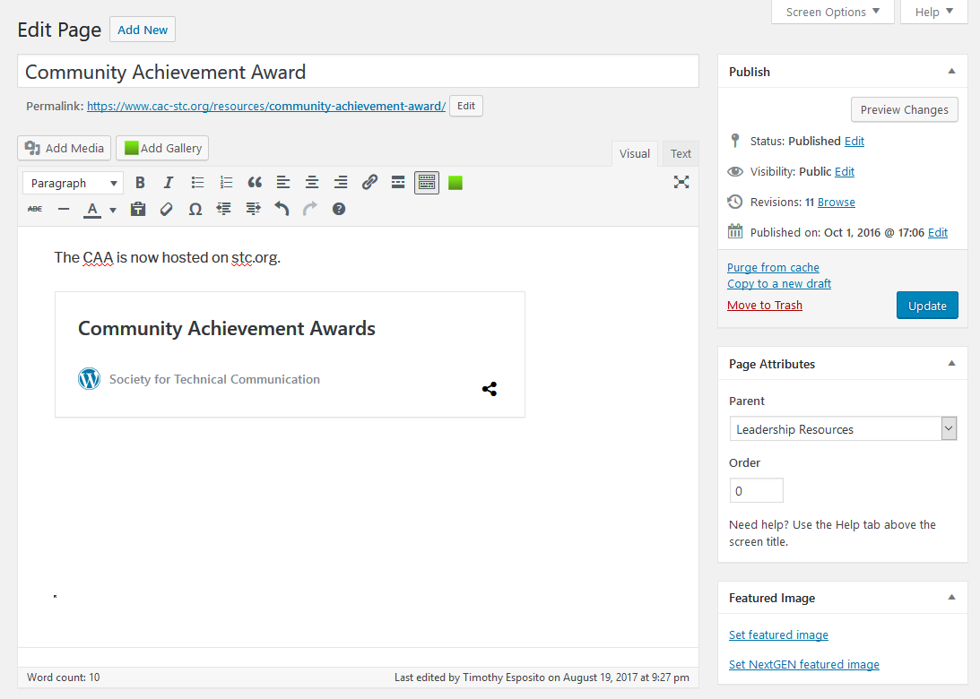
Pages – Editing
Notes:
Much like a post, you can control the publishing information. However, you can control the page hierarchy instead of using categories and tags. A well-structured website is a well-organized website, so take some time to create a plan for the site’s hierarchy. Your website visitors will thank you.

Slide 19
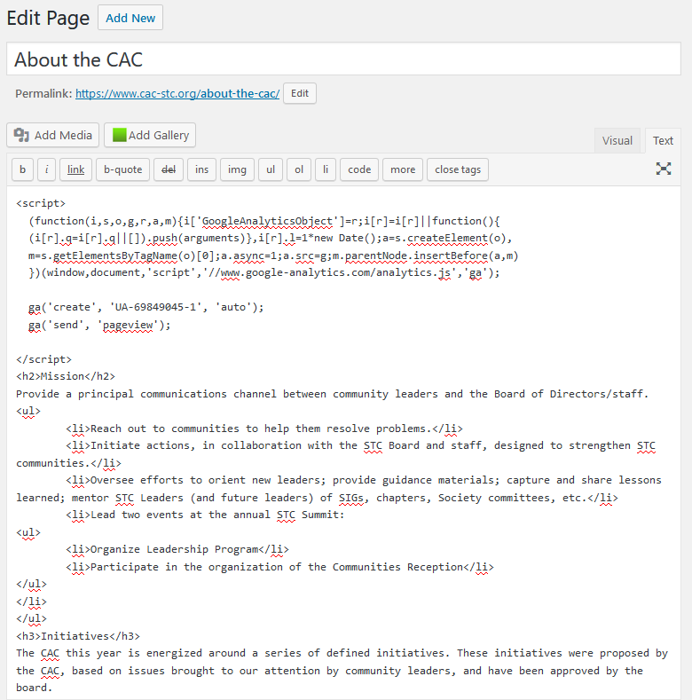
Editing Code
Notes:
On both pages and posts, you can switch from WYSIWYG to a basic HTML editor by clicking the “Text” tab. Some sites, like Google Analytics, may ask you to paste code. Use the HTML editor to clean up formatting if the WYSIWYG editor is being clunky with styles, especially if something was copied from another source and brought in to style definitions for each tag.

Slide 20
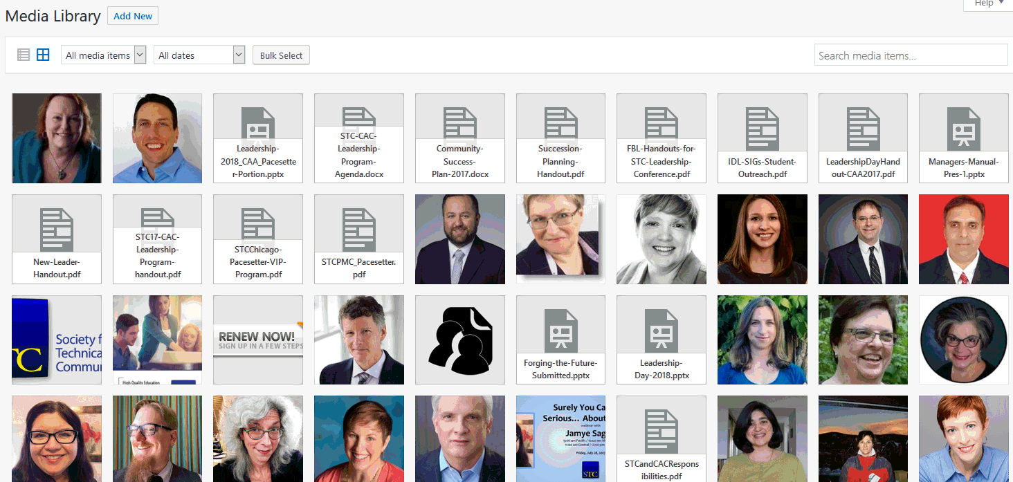
Media
Notes:
The Media library lets you organize any attachments that appear on the website, whether they are images or PDFs. You can sort by media type and can even see what media is not being referenced by the site.
Groom your library so you do not have duplicate images or files. By clicking on each piece of media, you can see where they are referenced. You can also sort by unreferenced media to see if you can remove it from your site.

Slide 21
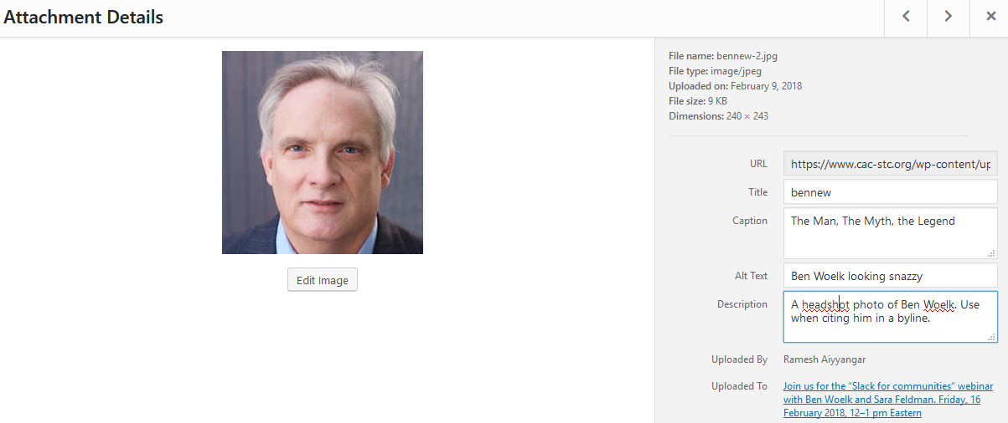
Media – Details
Notes:
When you click on a media item, you will see the URL to where the server has stored the file. Additionally, you can give it a useful title, a detailed caption, a description, and apply an Alt text caption for screen readers.
The caption automatically appears when you insert the image into a page or post.
The Alt text is what is shown if the photo does not display, or the page is accessed by a screen reader.
The description helps other website users determine when to use the photo.

Slide 22
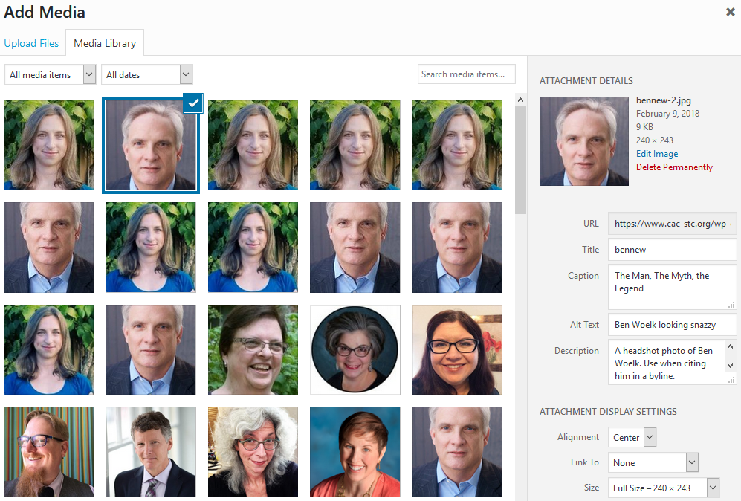
Media – Inserting
Notes:
On a post or page, you can click the “Insert Media” button to see a list of available media items for use. Each selected item’s details appear on the margin where you can add customizations, if needed.

Slide 23
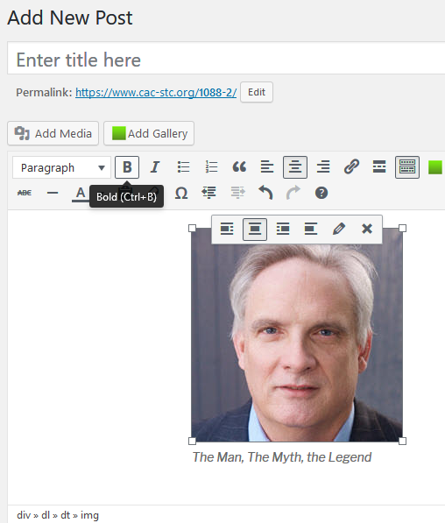
Media –Inserted
Notes:
When you insert media, it appears in the main editor. You can control the centering, or edit the details of the embedded object.

Slide 24
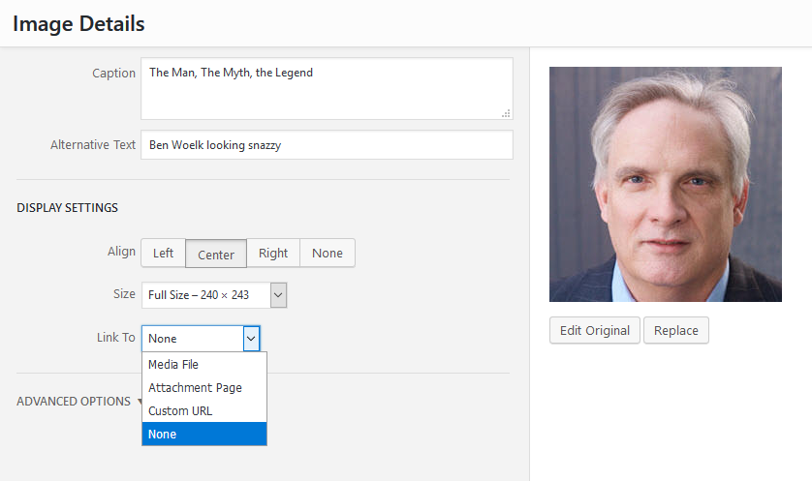
Media - Edited
Notes:
If you need to make further custom changes to inserted media, you can edit it for that page. Additionally, you can control what happens when someone clicks on the media. It may just open the image in greater detail, take them to a page for that image, go to a custom URL, or nothing.

Slide 25
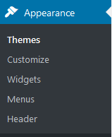
Appearance
Notes:
Appearance lets you customize the look and feel of your website.
Themes: Manages downloadable packages that ensure a consistent look and feel for the site.
Customize: Edits custom settings to your theme and site.
Widgets: Controls the sidebar items that appear on your site. For example: search bar, social media icons, recent post lists, RSS feeds, custom HTML, and categories.
Menus: Lets you structure your menu system.
Header: Allows you to edit the header, which is the top section of your site, typically the title for the page.

Slide 26
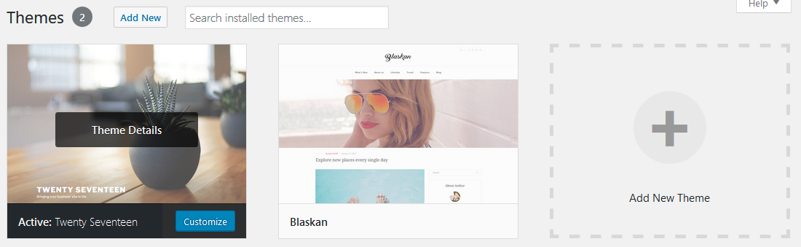
Appearance: Themes
Notes:
“Themes” control your website’s look and feel. Are there two columns or three? A large image at the top, or just text? What color and font scheme do you want? Some themes are meta themes which create a framework for subthemes that are designed to work similarly. Genesis is a meta theme example.
WordPress has free themes named after each year, such as Twenty Seventeen. Themes are sometimes updated, and you should update them and stay current. This usually does not cause any issues and can prevent security breaches.

Slide 27
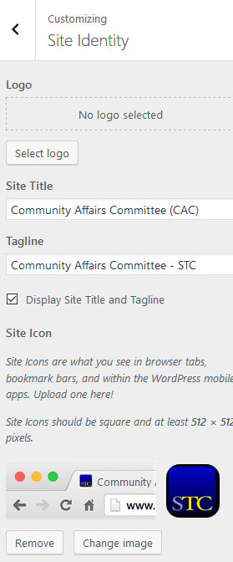
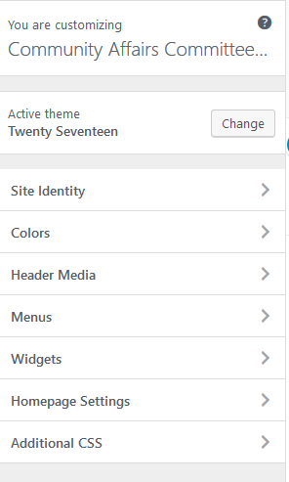
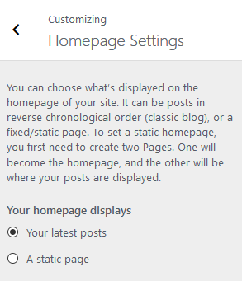
Appearance: Customize
Notes:
You can customize your site and theme. The customization level varies by theme, but they generally have these options. The site identity lets you control the website title and set a custom icon. The Homepage setting lets you set a static page as the homepage, or a feed of posts.

Slide 28
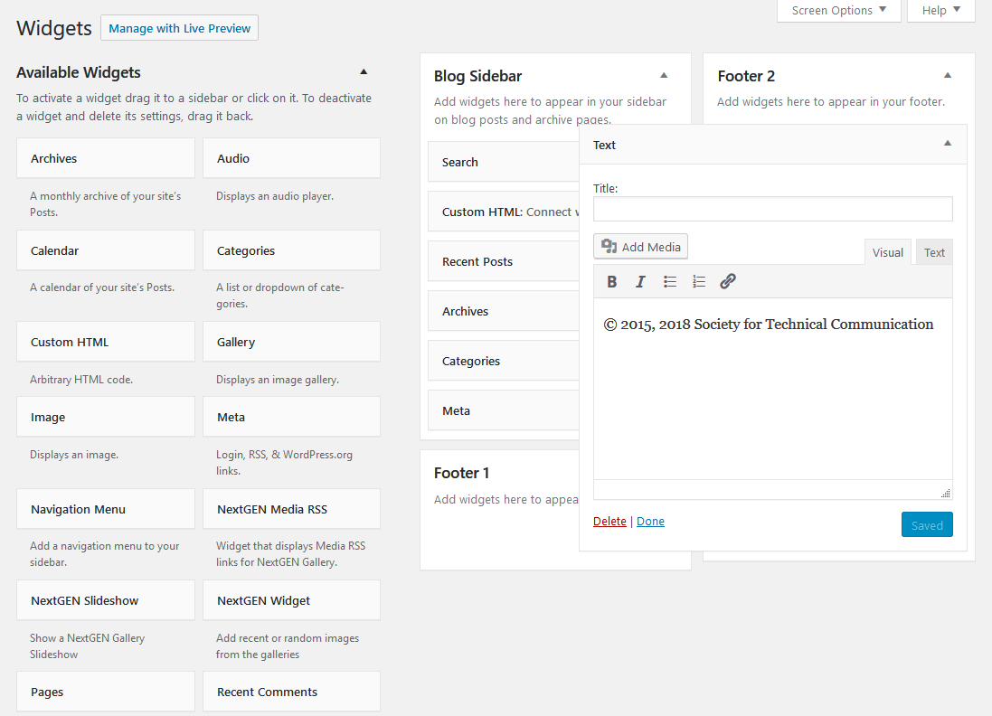
Appearance: Widgets
Notes:
“Widgets” are defined by WordPress and by your theme. Widgets vary, but common ones are Custom HTML, Images, Categories, and Text. You customize them and drag them to various sidebars and footers, where they will be displayed on the website. The theme controls the valid locations on your website to place widgets. If you drag the widgets to a different order on the editor, they will automatically change how they are displayed on the live page.

Slide 29
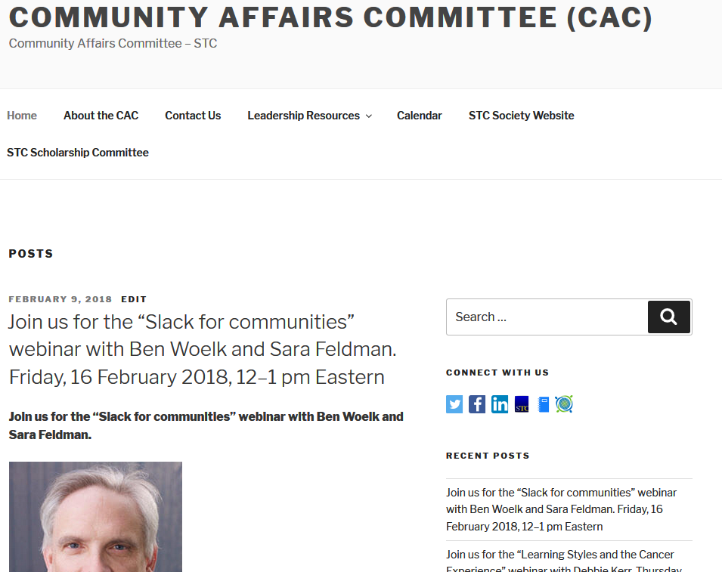
Appearance: Widgets
Notes:
In this sample, you see widgets for Search, Social Media Connections (via a custom HTML widget), and a widget showing a feed of recent posts. If you drag the widgets to a different order on the editor, they will automatically change how they are displayed on the live page.

Slide 30
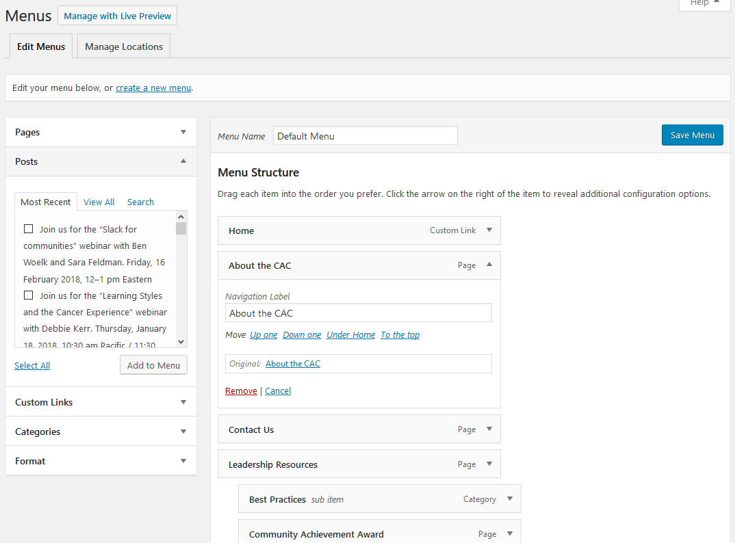
Appearance: Menus
Notes:
“Menus” are how you group your posts and pages on the site so visitors can easily find content. On a menu, you can link to a page, a post, a feed of posts designated by a category, or a custom URL to another site.
In the editor, select the menu items from the groups on the left and add them to the menu. Once in the menu, drag the object up, down, left, or right. Indenting it makes it a submenu item. Save the menu to make it live on your site.

Slide 31
Feeds
Use categories to group posts into feeds.
Pro Tip: Create menu items that are feeds instead of pages, so you do not need to maintain those pages. For example, create a menu for events, and make it a feed showing only your posts with the category “events”.
Your home page can be a series of all your posts, so it is always the latest news, much like a true blog.
Sticky posts are locked at the top of a feed.
Pro Tip: Use a sticky post to create static text on your homepage, with a feed of posts appearing below it.
Notes:
Use categories to group posts into feeds. Your home page can be a series of all your posts, so it is always the latest news, much like a true blog. Sticky posts are locked at the top of a feed.
Pro Tip: Create menu items that are feeds instead of pages, so you do not need to maintain those pages. For example, create a menu for events, and make it a feed showing only your posts with the category “events”.
Pro Tip: Use a sticky post to create static text on your homepage, with a feed of posts appearing below it.

Slide 32
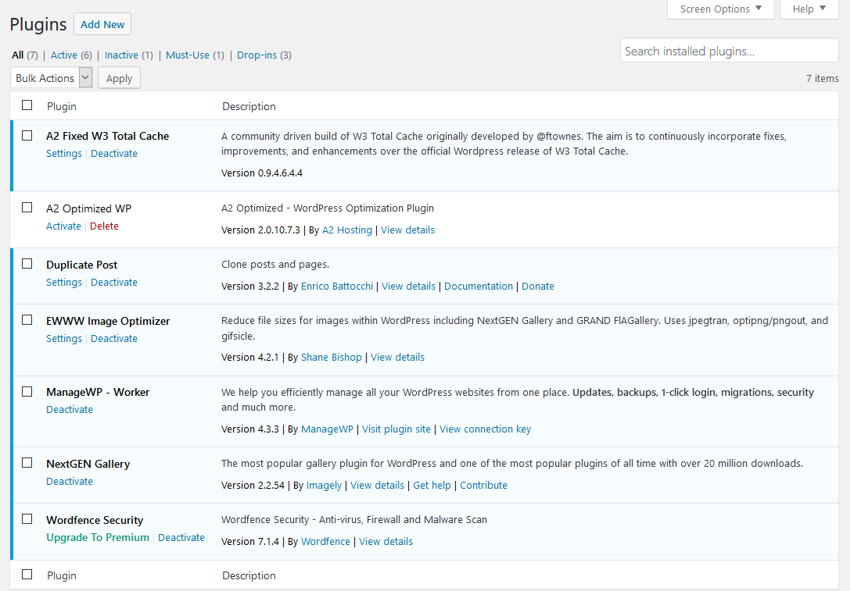
Plugins
Notes:
“Plugins” are little pieces of specialized code you can install into WordPress. Examples are:
One that creates a button letting you duplicate an existing post.
An image optimizer.
A cache to speed up your website.
A security plugin that alerts you about updates and possible attacks on your site.
Be careful with the plugins you select. If you find you are not using a plugin, remove it. Keep your plugins updated to help prevent security breaches.

Slide 33
Users
Administrator: someone who has access to all the administration features within a single site.
Editor: someone who can publish and manage posts including the posts of other users.
Author: someone who can publish and manage their own posts.
Contributor: someone who can write and manage their own posts but cannot publish them.
Subscriber: someone who can only manage their profile.
Notes:
“Users” are a list of people who can access your website’s control panel section. WordPress comes with several default user roles. Each has different powers.
Administrator: someone who has access to “all” the administration features for a single site.
Editor: someone who can publish and manage posts including the posts from other users.
Author: someone who can publish and manage their own posts.
Contributor: someone who can write and manage their own posts but cannot publish them.
Subscriber: someone who can only manage their profile.

Slide 34
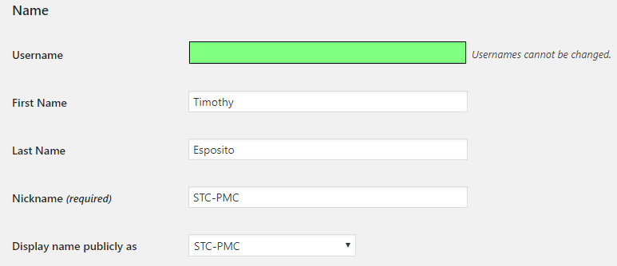
Users
Notes:
When defining a user, you must create an unchangeable user name. For the Administrator, do not choose “Admin” as that will be subject to hack attempts. Create a Nickname for yourself and use it to control how your posts are displayed on the site. It can be your real name or whatever you like. Do not make your Nickname the same as your Username, as that also gives hackers an advantage.

Slide 35
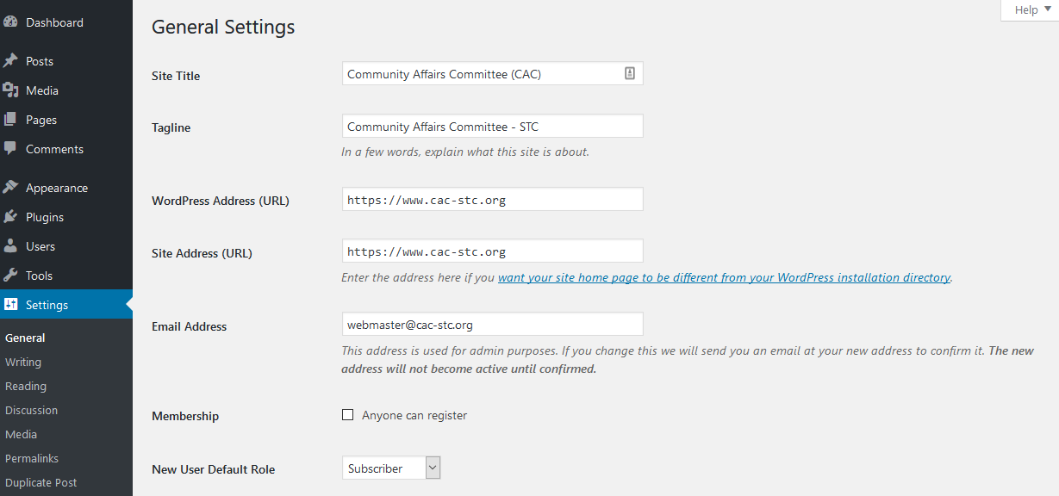
Settings
Notes:
“Settings” contain low-level configurations. Most do not need to be set; you can accept the defaults. Do review the General settings, like the Media setting so your media is NOT stored in folders based on the year/month you uploaded them.

Slide 36
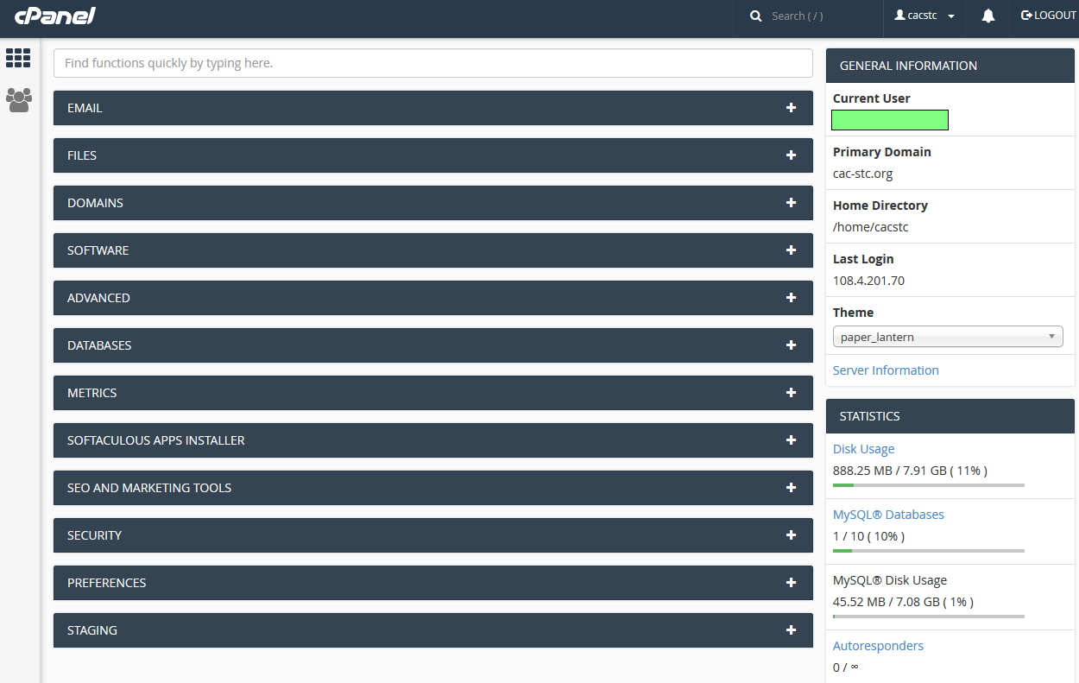
cPanel
Notes:
While WordPress is a handy front-end to your website creation, you also have access to powerful behind-the-scenes tools. cPanel is one of the most common toolsets that hosting companies provide. Your hosting company will provide you with a URL and logon credentials for your site’s cPanel. cPanel is very powerful and should not be taken lightly. We’ll go through some of the more popular cPanel features.

Slide 37
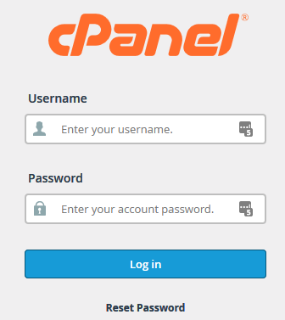
cPanel – Logging on
Notes:
Go to cPanel and sign in with the logon information provided by the hosting company.

Slide 38
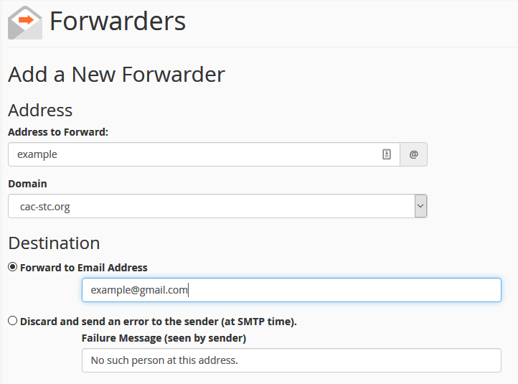
Email forwarding
Notes:
A popular feature is to create an email forwarder. A forwarder lets you create a fake email using your domain’s address, such as @cac-stc.org. Whenever a message is sent to that address, it is forwarded to a real monitored email account. That way you can put these accounts as links on your website, and if the person receiving the emails stops working with you, you just change the forwarder to point to the new person’s address. To the public, there is no change in address. Additionally, you can assign multiple addresses by duplicating the forwarders. This is handy if you want to be copied on all incoming correspondence to another public email address. It also saves you from making personal email addresses public on a website, potentially reducing spam to those accounts.

Slide 39
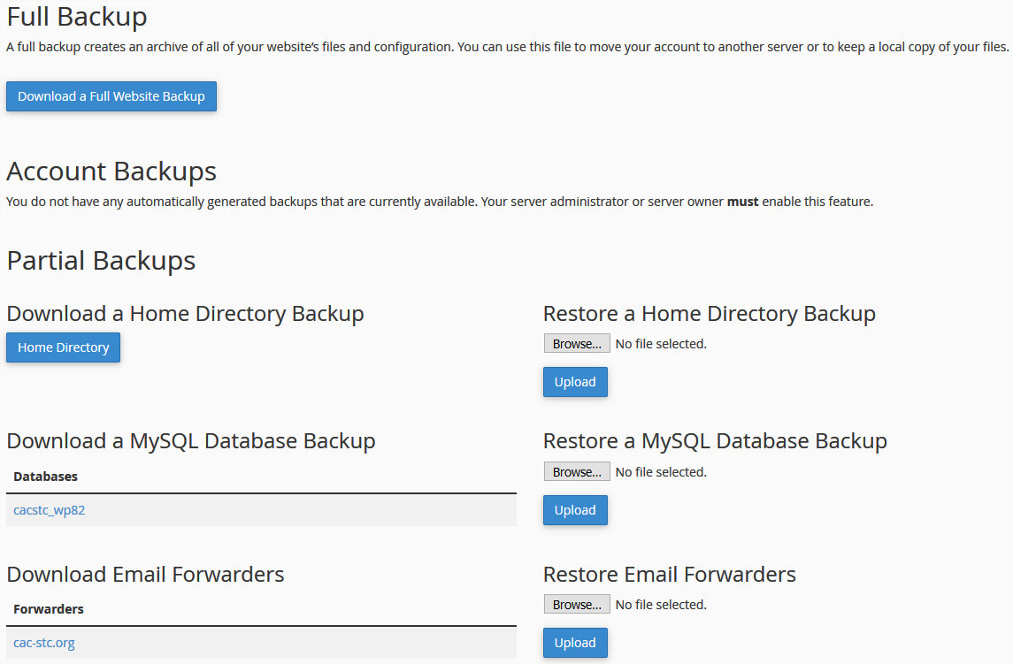
Backup
Notes:
You should have a regular backup schedule established for your webmaster, such as the first of every month. You can do a Full Backup, which is designed for moving your site to another server. I recommend downloading backups of your home directory, your MySQL Database, and your email forwarders. Those offer easy-to-restore options in case something fails on your site.

Slide 40
Quick List of Tasks for a Webmaster
Pick a theme that works for your site.
  Update the theme regularly.
Make sure WordPress is updated regularly.
Update and review plugins regularly.
Backup the website at least monthly.
Manage user access.
Maintain email forwarders in cPanel.
Update the copyright date for your page.
Maintain domain registration.
Groom your media library so duplicate files are removed.
Ensure post categories are clearly used, so feeds work.
Notes:
Pick a theme that works for your site.
Update the theme regularly.
Update WordPress regularly.
Update and review plugins regularly.
Backup the website at least monthly.
Manage user access.
Maintain email forwarders in cPanel.
Update the copyright date for your site.
Maintain domain registration.
Groom your media library so duplicate files are removed.
Ensure post categories are clearly used so feeds work.

Slide 41
Mastering Your Website 201
More details on customizing your site.
Connecting your site with social media.
Plugin Management
  Implementing security plugins on your site.
Getting HTTPS integrated on your site.
cPanel
  Antivirus
  File Manager
FTP
SEO (Search Engine Optimization)
Event Calendar Integration
Subscribe to mail list widgets
Google Analytics
Notes:
More details on customizing your site.
Connecting your site with social media.
Plugin Management
Implementing security plugins on your site.
Getting HTTPS integrated on your site.
cPanel
Antivirus
File Manager
FTP
SEO (Search Engine Optimization)
Event Calendar Integration
Subscribe to mail list widgets
Google Analytics

Slide 42
References
WordPress for Dummies
WordPress: The Missing Manual
https://www.cac-stc.org/customizing-your-chapter-email-addresses/
Notes:
WordPress for Dummies
WordPress: The Missing Manual
https://www.cac-stc.org/customizing-your-chapter-email-addresses/

Slide 43
Thanks
Roger Renteria
Paul Mueller
Ben Woelk and his headshot
Danielle Villegas
Adam Evans
Jamye Sagan
Jeff Strong
Phoebe Forio
Steven Jong
Notes:
These helpful resources gave me ideas on what they wanted to see in a webinar on websites.

Slide 44
Contact info
tmesposit@gmail.com
https://twitter.com/tmesposit
https://tmesposit.wordpress.com/
https://www.linkedin.com/in/timothyesposito/
Notes:
Connect with me at any of these sites.
tmesposit@gmail.com
https://twitter.com/tmesposit
https://tmesposit.wordpress.com/
https://www.linkedin.com/in/timothyesposito/

